Slide 1
What is Biomaterial?
«A biomaterial is any matter, surface, or construct that interacts with biological systems»
The study of biomaterials is called biomaterials science. It has experienced steady and strong growth over its history, with many companies investing large amounts of money into the development of new products. Biomaterials science encompasses (includes) elements of medicine, biology, chemistry, tissue engineering and materials science.
Biomaterials can be derived either from nature or synthesized in the laboratory. They are often used and/or adapted for a medical application, and thus comprises (oluşturmak) whole or part of a living structure or biomedical device which performs, augments (çoğaltmak), or replaces a natural function.

Slide 2
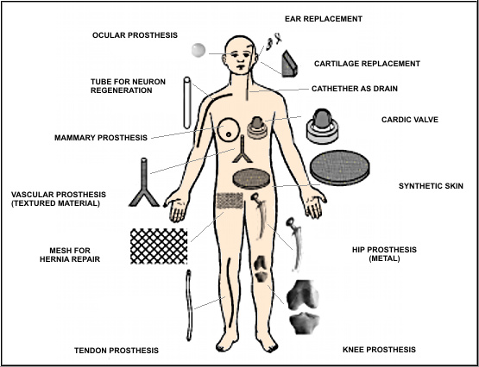
Hernia: fıtık
Drain: iltihaplı yerden cerahat çeken tüp
http://bionews-tx.com/biomaterials-biospecimens/

Slide 3
Some polymers currently used clinically and some of their applications
Poly(methymethacrylate): Rigid contact lenses, intra-ocular lens
Polymeric compounds based on methyl methacrylate: Acrylic cements for orthopedy and odontology, facial prostheses, joint surgeries, filling of bone cavities and porous bony tissues
Poly(2-hydroxyethyl methacrylate): Flexible contact lenses, plastic surgery, hemocompatibility of surfaces
Nylon-type polyamides: Sutures
Poly(vinyl chloride): Catheters
Poly(ethylene terephtalate): Vascular protheses, cardiac valves
Polytetrafluoroethylene: Orthopedy, vascular clips
Polyurethanes: Catheters, cardiac pumps
Silicones: Plastic surgery and tubes.

Slide 4
Definitions of Biocompatibility
«The ability of a material to perform with an appropriate host response in a specific application» Williams' definition*.
It was defined in the European Society for Biomaterials Consensus Conference I in 1976.
Biocompatibility: Ability to be in contact with a living system without producing an adverse effect. IUPAC Recommendations 2012**
*The Williams Dictionary of Biomaterials, D.F. Williams, 1999, ISBN 0-85323-921-5
**"Terminology for Biorelated Polymers and Applications". Pure and Applied Chemistry 84 (2): 377–410. 2012.

Slide 5
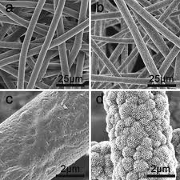
Bioactive
«Qualifier (niteleyici) for a substance that provokes any response from a living system. IUPAC Recommendations 2012
*The concept of bioactivity does not imply (kastetmek) beneficial action only, although the term is often used positively, i.e., to reflect a beneficial action.
In the study of biomineralization, bioactivity is often meant as the formation of calcium phosphate deposits on the surface of objects placed in simulated body fluid SBF, a buffer solution with ion content similar to blood.

Slide 6
Bioinert
Biologically inert, or bioinert materials are ones which do not initiate a response or interact when introduced to biological tissue. In other words, introducing the material to the body will not cause a reaction with the host. Originally, these materials were used for vascular surgery due to the need for surfaces, which do not cause clotting of the blood. For this reason bioinert materials may sometimes also be called haemocompatible.
Realistically, most materials are not completely bioinert and no synthetic material is bioinert. Some examples of bioinert, or very close to bioinert substances are tianium-aluminum-vanadium alloy (used in hip replacements) and diamond.
Haemocompatibility: In biomedical engineering, haemocompatibility is the compatibility of a material with blood.

Slide 7
Biodegredable vs Biostable
The current trend predicts that in the next couple of years, many of the permanent prosthetic devices used for temporary therapeutic applications will be replaced by biodegradable devices that could help the body to repair and
regenerate the damaged tissues.
There are several reasons for the favorable consideration of biodegradable over biostable materials for biomedical applications:
Long-term biocompatibility issues with many of the existing permanent implants
Revision surgeries.

Slide 8
Important properties of a biodegradable biomaterial
The material should not evoke a sustained (sürekli) inflammatory or toxic response upon implantation in the body.
The material should have acceptable shelf life.
The degradation time of the material should match the healing or regeneration process.
The material should have appropriate mechanical properties for the indicated application and the variation in mechanical properties with degradation should be compatible with the healing or regeneration process.
The degradation products should be non-toxic, and able to get metabolized and cleared from the body.

Slide 9
Biodegradable polymeric materials are being investigated in developing therapeutic devices such as:
Temporary prostheses
Scaffolds for tissue engineering
Pharmacological applications, such as drug delivery
Some current biomedical applications of biodegradable polymeric materials:
Large implants, such as bone screws, bone plates and contraceptive reservoirs
Small implants, such as staples, sutures and nano- or micro-sized drug delivery vehicles
Plain membranes for guided tissue regeneration
Multifilament meshes or porous structures for tissue engineering

Slide 10
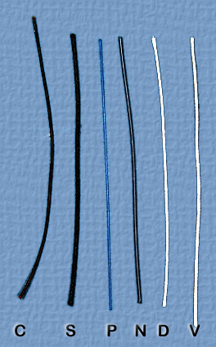
Silk.
Silk has been largely replaced by synthetic materials.
Silk is very strong and handles nicely.
The main disadvantages are: Tissue reaction
Catgut.
It was made from pig or cow intestine, not from the gut of a cat.
Pure catgut causes an intense tissue reaction as it is absorbed within 3-5 days. This makes it largely unacceptable today.
Catgut soaked in chromic acid, chromic catgut, causes a less intense reaction and is absorbed faster than most synthetic absorbable stitches.
Catgut is rather tough when dry and tends to fray.
When wet, catgut is slippery and the knots slip.
C = Catgut
S = Silk
P = Polypropylene
N = Nylon
D = Dexon
(Polyglycolide)
V = Vicryl
(Poly(glycolide90-lactide10))

Slide 11



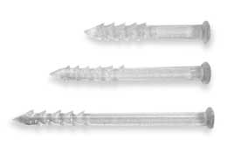

SmartScrew-Bionx
    Self-reinforced PLLA
    2.0, 2.7, 3.5, 4.5 mm
    4.5 mm cannulated
    36-60 moisture absorb.
    90% at 24 weeks
    $120-$190
Notes:
L1 Fully threaded smart screw. R1 Partial L2 Cannulated R2 Smartnails L3 SmartPin

Slide 12
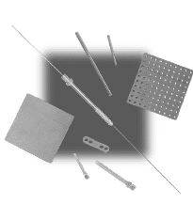
ReUnite by BioMet
    82% PLLA
    18% PGA
    2.0, 2.5, 3.0, 5.0 mm
    Cannulated
    9-15 moisture absorb.
    70% at 6-8 weeks
    $125-$227

Slide 13
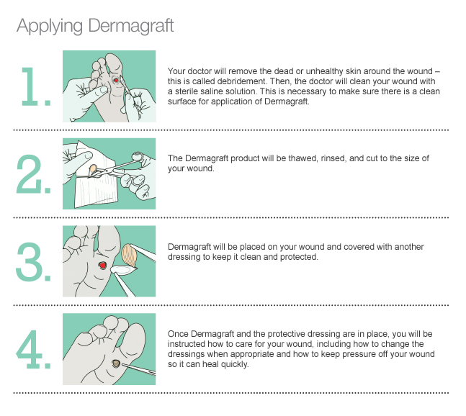
Dermagraft®, consists of human fibroblasts (cells which produce the collagen fibers that make up connective tissue) seeded in PLGA.

Slide 14
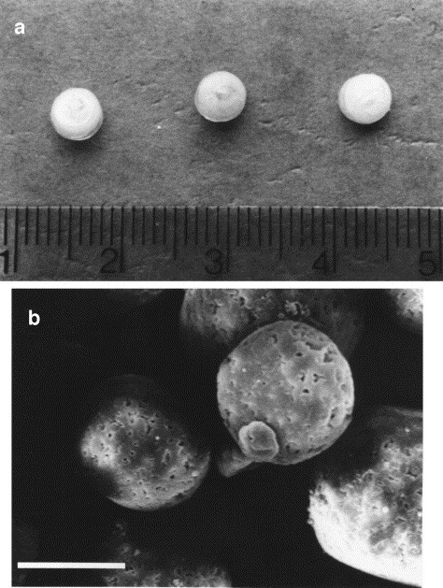
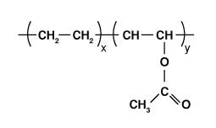
Typical controlled drug delivery systems.
Solid particles of dopamine were dispersed within an EVAc matrix (ethylene-vinyl acetate copolymer) and coated with a rate-limiting EVAc membrane. The polymer pellets release dopamine at a constant rate for many months following implantation. The ruler is scaled in cm; each pellet diameter is ∼0.3 cm.
Scanning electron micrograph of PLGA microspheres containing dispersed antibody particles. The antibodies are released at a constant rate from these small spheres for over one month. The scale bar indicates 0.01 cm.
Antibody: (antikor) a special protein produced by the body's immune system that recognizes and helps fight infectious agents and other foreign substances that invade the body

Slide 15
Biodegredation
Biodegradation of polymeric biomaterials involves cleavage of hydrolytically or enzymatically sensitive bonds in the polymer leading to polymer erosion.
Depending on the mode of degradation, polymeric biomaterials can be classified as:
Hydrolytically degradable polymers
Enzymatically degradable polymers

Slide 16
Enzymatically Degradable Polymers
Most of the naturally occurring polymers undergo enzymatic degradation. The rate of in vivo degradation of enzymatically degradable polymers varies significantly with the site of implantation depending on the availability and concentration of the enzymes. Chemical modification of these polymers also can significantly affect their rate of degradation.
The inherent bioactivity of the natural polymers has its own downsides:
Immunogenic response associated with most of the polymers,
Complexities associated with their purification
Possibility of disease transmission
Synthetic biomaterials are generally biologically inert, but they have more predictable properties and batch-to-batch uniformity compared to natural polymers.

Slide 17
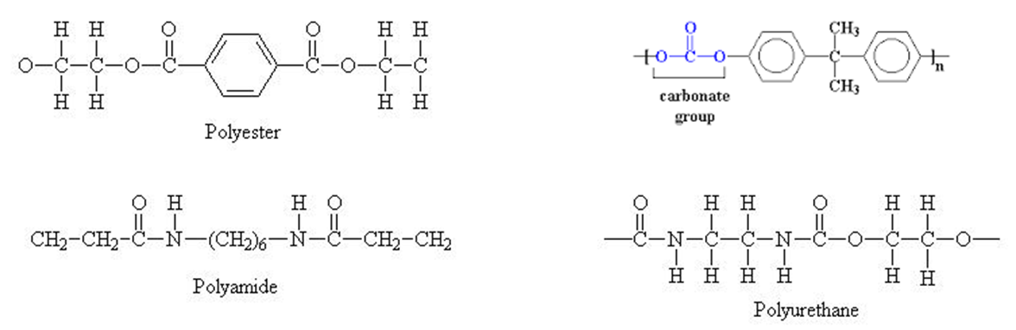
Hydrolytically Degradable Polymers
Hydrolytically degradable polymers are polymers that have hydrolytically labile chemical bonds in their back bone. The functional groups susceptible to hydrolysis include esters, carbonates, amides, urethanes etc.
Hydrolytically degradable polymers are generally preferred as implants due to their minimal site-to-site and patient-to-patient variations compared to enzymatically degradable polymers . The successful performance of the first synthetic poly(glycolic acid) based suture system during the late 1960s led to the design and development of new biodegradable polymers as transient implants for medical applications.

Slide 18
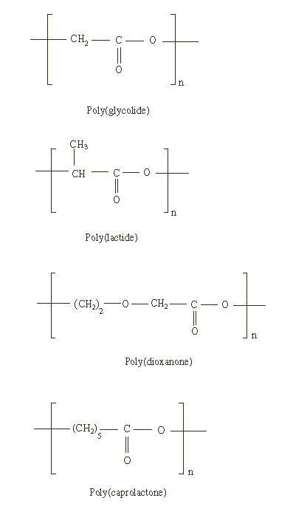
Poly(α-esters)
Poly(α-ester)s are thermoplastic polymers with hydrolytically labile aliphatic ester linkages in their backbone. Although all polyesters are theoretically degradable only aliphatic polyesters with reasonably short aliphatic chains between ester bonds can degrade over the time frame required for most of the biomedical applications.
Poly(α-ester)s comprise the earliest and most extensively investigated class of biodegradable polymers. Among the class of poly(α-ester)s, the most extensively investigated polymers are poly(glycolic acid) and poly(lactic acid).

Slide 19
Polyglycolide
Polyglycolide is a highly crystalline polymer (45–55% crystallinity) and therefore exhibits a high tensile modulus with very low solubility in organic solvents (exhibit a modulus of approximately 12.5 Gpa). The glass transition temperature of the polymer ranges from 35 to 40 °C and the melting point is greater than 200 °C. Polyglycolide shows excellent mechanical properties due to its high crystallinity therefore polyglycolides have been investigated as bone internal fixation devices (Biofixs).
Due to its excellent fiber forming ability, polyglycolide was initially investigated for developing resorbable sutures. The first biodegradable synthetic suture called DEXONs that was approved by the United States (US) Food and Drug Administration (FDA) in 1969 was based on polyglycolide.
Non-woven polyglycolide fabrics have been extensively used as scaffolding matrices for tissue regeneration due to its excellent degradability, good initial mechanical properties and cell viability on the matrices.

Slide 20
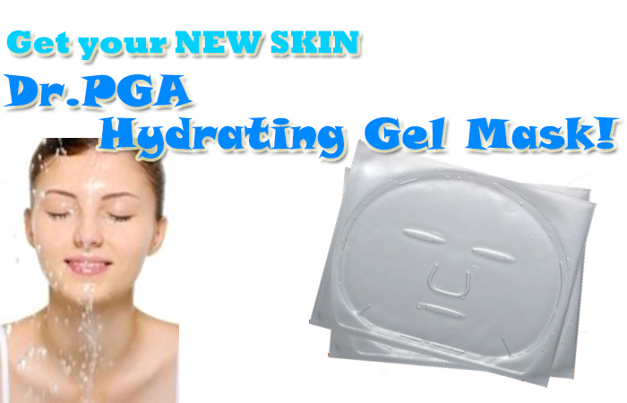
Polyglycolide
The polymer is known to lose its strength in 1–2 months when hydrolyzed and losses mass within 6–12 months. In the body, polyglycolides are broken down into glycine which can be excreted in the urine or converted into carbon dioxide and water via the citric acid cycle .
The high rate of degradation, acidic degradation products and low solubility however, limit the biomedical applications for polyglycolide. Therefore, several copolymers containing glycolide units are being developed to overcome the inherent disadvantages of polyglycolide.

Slide 21

Polylactide
Similar to polyglycolide, poly(L-lactide) (PLLA) is also a crystalline polymer (37% crystallinity). It has a glass transition temperature of 60–65 °C and a melting temperature of approximately 175 ° C. Poly(L-lactide) is a slow-degrading polymer compared to polyglycolide, has good tensile strength and a high modulus (approximately 4.8 GPa) and hence, has been considered an ideal biomaterial for load bearing applications, such as orthopaedic fixation devices. (BioScrews, Bio-Anchors, etc.)
PLLA can also form high strength fibers and was FDA approved in 1971 for the development of an improved suture over DEXONs.
An injectable form of PLLA (Sculptras) has recently been approved by the FDA for the restoration or correction of facial fat loss.

Slide 22

Sculptra
Sculptra is an injectable product that restores and corrects the signs of facial fat loss by replacing lost volume.
Sculptra is composed of poly-L-lactic acid. Poly-L-lactic acid (PLLA) is a biocompatible , biodegradable material that has been widely used for many years in surgical products. The effects are long-lasting; they were shown in a clinical study to last for up to 2 years after the first treatment session.

Slide 23
Polylactide
However, being more hydrophobic than polyglycolide, the degradation rate of PLLA is very low. High molecular weight PLLA can take between 2 and 5.6 years for total resorption in vivo. The rate of degradation however, depends on the degree of polymer crystallinity as well as the porosity of the matrix. Even though the polymer is known to lose its strength in approximately 6 months when hydrolyzed, no significant changes in mass will occur for a very long time.
Polylactides undergo hydrolytic degradation via the random scission of the ester backbone. It degrades into lactic acid a normal human metabolic by-product, which is broken down into water and carbon dioxide via the citric acid cycle.

Slide 24
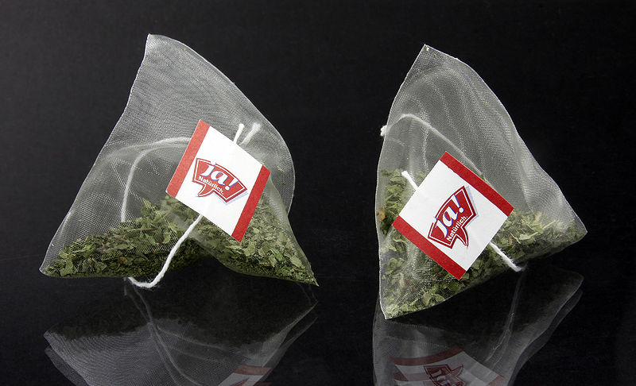
Tea bags are commonly made of filter paper, silk or food grade plastic (PLA).

Slide 25
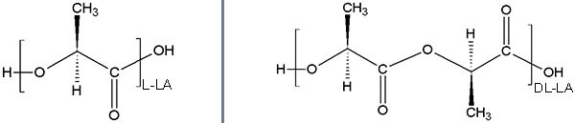
Poly(DL-lactide)
Poly(DL-lactide) (PDLLA) is an amorphous polymer due to the random distribution of L- and D-lactide units and has a glass transition temperature of 55–60 °C. The polymer shows much lower strength (1.9 GPa) compared to poly(L-lactide). This polymer loses its strength within 1–2 months when hydrolyzed and undergoes a loss in mass within 12–16 months. Being a low strength polymer with faster degradation rate compared to poly(L-lactide), it is a preferred candidate for developing drug delivery vehicles and as low strength scaffolding material for tissue regeneration.

Slide 26
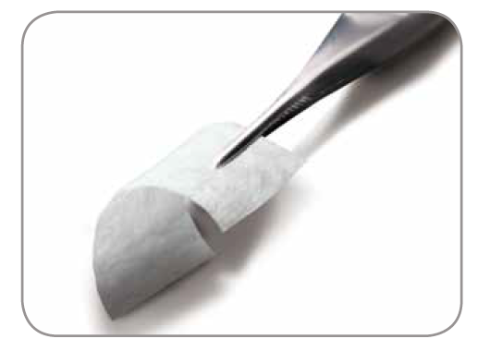
Poly(lactide-co-glycolide)
Different ratios of poly(lactide-co-glycolides)have been commercially developed and are being investigated for a wide range of biomedical applications.
PANACRYL is commercially developed suture from the co-polymer with a higher LA/GA ratio in order to decrease the rate of degradation. (Also, PuraSorbs 80L:20G, Vicryls 90G:10L etc.)
Other applications of PLGA are in the form of meshes (Vicryl Meshs). The tissue engineered skin graft (Dermagrafts) use a Vicryl Meshs as the scaffolding structure. PLGA demonstrates good cell adhesion and proliferation making it a potential candidate for tissue engineering applications.
PLGA-collagen matrix is currently in the market (CYTOPLAST Resorbs) as a guided
tissue regeneration membrane.

Slide 27
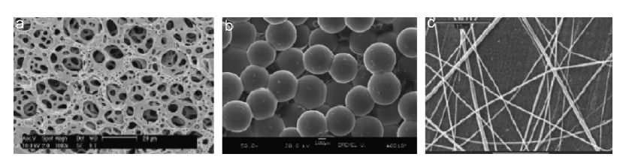
Several drug delivery vehicles composed of PLGA, such as microspheres, microcapsules, nanospheres and nanofibers have been developed for the controlled release of drugs or proteins. LUPRON DEPOT is a drug delivery vehicle composed of PLGA used for the release of a gonadotropin releasing hormone analog for prostate cancer.
Figure. Porous three-dimensional structures developed from PLGA using (a) gas foaming (b) microsphere sintering and (c) electrospinning.

Slide 28
Polycaprolactone
Polycaprolactone (PCL) is a semicrystalline polyester: melting point (55–60°C) and glass transition temperature (60°C). PCL has low tensile strength (approximately 23MPa) but an extremely high elongation at breakage (4700%).
It is of great interest as it can be obtained from a cheap monomeric unit.
The PCL is highly processible as it is soluble in a wide range of organic solvents, while having the ability to form miscible blends with wide range of polymers.
The polymer undergoes hydrolytic degradation however, the rate of degradation is rather slow (2–3 years).
Due to the slow degradation, high permeability to many drugs and non-toxicity, PCL
was initially investigated as a long-term drug delivery vehicle. The long-term contraceptive device Capronors, is composed of this polymer and has been developed for the long-term release of levonorgestrel.
Composites of PCL with calcium phosphate based ceramics are also currently being investigated as suitable scaffolds for bone tissue engineering.

Slide 29
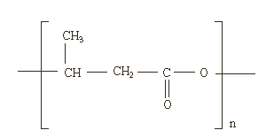
Bacterial polyesters
Bacterial polyesters are naturally occurring biodegradable polyesters produced by many bacteria as their energy source. The most common polymer among this class is poly(3-hydroxybutyrate) (PHB), which was discovered in 1920 as produced by the
bacteria ‘‘Bacillus megaterium’’. In addition to a bacterial synthetic route, several chemical synthetic routes have been developed for PHB synthesis.
It is a semi-crystalline polymer that undergoes surface erosion by hydrolytic cleavage of the ester (melting temperature in the range of 160–180°C and glass transition temperature in the range of -5 to 20°C).
The co-polymers of PHB and 3-hydroxyvalerate P(HBHV) have similar semicrystalline properties as PHB; however, the melting temperature is lower depending on the HV content. Both PHB and P(HB-HV) have been found to be soluble in a wide range of solvents and can be processed into different shapes and structures, such as films, sheets, spheres and fibers.

Slide 30
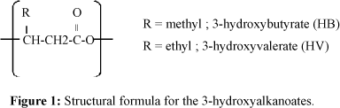
Bacterial polyesters
The hydrolytic degradation of PHB results in the formation of 3-hydroxy-butyric acid which is a normal constituent of blood. However, PHB has a rather low degradation rate in the body compared to synthetic polyesters presumably due to its high crystallinity. The co-polymer, PHBV, being less crystalline undergoes degradation at a much faster rate.
The in vivo degradation of these polymers is slow, although not many degradation studies have been performed. As such, PHB and PHBV may be potential biodegradable candidates for long term implants. Attempts are currently underway to increase the rate of degradation of these polymers by blending them with more hydrophilic polymers or other low molecular weight additives to increase water penetration and facilitate degradation.
It is a good candidate for developing drug delivery vehicles.

Slide 31
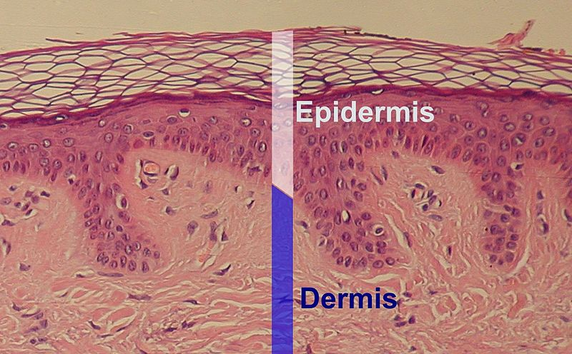
Skin substitutes
will have an enormous impact on the care of patients with serious burns.
Skin, the body’s largest organ, is incredibly complex. Functionally there are two layers with a highly specialized and effective bonding mechanism:
Epidermis, provides bacterial barrier preventing pathogens from entering, making the skin a natural barrier to infection and regulates the amount of water released from the body into the atmosphere. It is 95% keratinocytes (cell type).
Dermis, provides strength and elasticity. The dermis is composed of three major types of cells: Fibroblasts, Macrophages and Adipocytes. Apart from these cells, the dermis is also composed of matrix components such as collagen (which provides strength) and elastin (which provides elasticity).
Histologic image of epidermis, delimited by white bar.

Slide 32
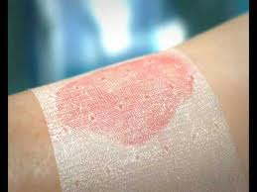
Synthetic Skin substitutes
An increasing number of semipermeable membrane dressings provide a vapor and bacterial barrier and control pain while the underlying wound or donor site re-epithelializes.
Biobrane : It is a biosynthetic semi-permeable membrane designed to temporarily perform the functions of lost epidermis until re-epithelialisation. It is a two-layer membrane consisting of an inner layer of a woven non-biodegradable nylon mesh that allows fibrovascular ingrowth and an outer layer of silicone film that serves as a vapor and bacterial barrier. Peptides derived from porcine collagen are bonded to all exposed nylon and silicone surfaces. The material bonds firmly to the adequately prepared bed of an appropriate burn until spontaneous detachment by re-epithelialisation. It is a lightweight material; being packaged and stored as dry sheets and has a long shelf-life.
http://www.youtube.com/watch?v=CjFrkK8nr3k

Slide 33
Enzymatically degradable polymers as biomaterials
Collagen
It is the most abundant protein present in the human body being the major component of skin and other musculoskeletal tissues. There have been more than 22 different types of collagen identified so far in the human body. Type I collagen is the single most abundant protein present in mammals and is the most thoroughly studied protein.
Collagen is mostly soluble in acidic aqueous solutions and can be processed into different forms such as sheets, tubes, sponges, foams, nanofibrous matrices, powders, injectable viscous solutions and dispersions.
Studies have also shown that the degradation rate of collagen used for biomedical applications can be significantly altered by cross-linking using various cross-linking agents.

Slide 34
Collagen
Collagen is one of the primary initiators of the coagulation cascade and its high thrombogenicity* has led to its application as a haemostatic** agent. Several collagen-based hemostats are currently on the market.
Since collagen forms the major component of the extracellular matrix and serves as a natural substrate for cell attachment, proliferation and differentiation, interest in collagen as an ideal matrix material for tissue engineering and wound dressing application has occurred.
Orcels and Apligrafs are other FDA approved collagen-based bilayer dressings seeded with live human keratinocytes and fibroblasts for the treatment of chronic ulcers.
Collagen has been extensively investigated for the localized delivery of low molecular weight drugs including antibiotics. Several collagen-based gentamicin delivery vehicles are currently on the market world-wide (Sulmycins-Implant, Collatamps-G).
Concerns include, the high cost of pure collagen, variable physico-chemical and degradation properties and the risk of infectious diseases transmission due to the natural origin of the material.
*tendency of a material in contact with the blood to produce a thrombus, or clot.
**something that stops a flow of blood

Slide 35
Chitin and Chitosan
(Polysaccharides of non-human origin)
Chitin is the structural element in the exoskeleton of crustaceans (such as crabs and shrimp) and cell walls of fungi. Chitosan is produced commercially by deacetylation of chitin. The degree of deacetylation (%DD) in commercial chitosans ranges from 60 to 100%
The rate of degradation and solubility of chitosan inversely depends on the %DD and crystallinity of the polymer. The faster degradation rate has been attributed to the deformation of strong hydrogen bonds present in chitosan.

Slide 36
Chitin and Chitosan
Chitosan is soluble in weekly acidic solutions resulting in the formation of a cationic polymer with a high charge density and can therefore form polyelectrolyte complexes with wide range of anionic polymers.
Chitosan can be fabricated into various structures and forms, such as gels, nanofibers, nanospheres, microspheres and combined with its pH sensitivity, excellent biocompatibility and biodegradability, makes chitosan a promising candidate for developing drug delivery devices and as scaffolds for tissue engineering.
Chitin and chitosan have shown to have stimulatory properties on macrophages*, and chemoattractive properties on neutrophils**. These properties, along with its antibacterial, hemostatic properties give chitosan enourmous potential as a natural polymer for wound healing applications.
*A type of white blood cell that engulfs and digests foreign substances, microbes and cancer cells.
**The most abundant type of white blood cells in mammals and form an essential part of the innate immune system.

Slide 37
Polymeric Micro- and Nanoparticles as Drug Carriers

Slide 38
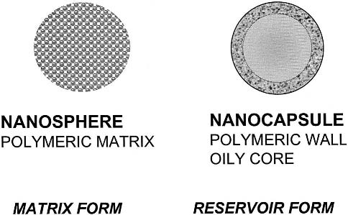
‘‘Nanosphere’’ is used to identify a nanoparticle system with a matrix character and constituted by a solid core with a dense polymeric network.
‘‘Nanocapsules’’ are formed by a thin polymeric envelope surrounding an oil-filled
cavity. Nanocapsules may thus be considered as a ‘‘reservoir’’ system.
In practice, the term nanoparticles is also used (instead of nanospheres) to designate
polymeric colloidal systems with a matrix structure.

Slide 39
*Synthetic polymeric NPs, e.g. constructed from the polyester poly(lactic acid) (PLA) and its copolymer with poly(glycolic acid), i.e. poly(lactic-co-glycolic acid) (PLGA), have been studied extensively for drug delivery purposes over the last few decades. Their biodegradable and biocompatible features largely account for their widespread use in biomedical applications and justify the approval of PLGA micro- and nanoparticles for human use in drug delivery by the FDA and the European Medicine Agency (EMA).

Slide 40
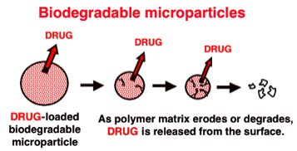
Biodegradable Drug Delivery Systems
The polymers used in the formulation and fabrication of biodegradable drug delivery devices erode (with or without changes to the chemical structure) or degrade (breakdown of the main chain bonds) as a result of the exposure to chemicals (water) or biologicals (enzymes). The drug molecules, which are initially dispersed in the polymer, are released as the polymer starts eroding or degrading as shown below.
The polymer erodes or degrades to release drug molecules in degradable devices.

Slide 41
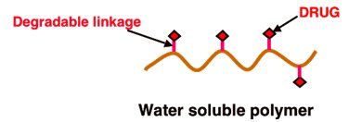
The degradable reservoir system has a drug-loaded core surrounded by a polymer coating that degrades or erodes. These systems combine the advantage of long-term constant rate drug release with bioerodability or biodegradability. In pendant-chain systems, the drug molecules are covalently attached to the main polymer chain via degradable linkages. So, as the polymer is exposed to water or chemicals, the linkages break down releasing the drug.
Pendant-chain systems have degradable linkages that release drug molecules upon exposure to water.

Slide 42
Responsive Drug Delivery Systems
Classified as open- or closed-loop systems:
Open-loop systems are also called pulse or externally regulated systems; the amount of drug released is not dependent on the environmental conditions the device is in. The rate of drug released can also be controlled and enhanced using external stimulants like magnetism and ultrasound.
In magnetically-controlled drug delivery devices, small magnetic spheres are embedded in a drug-containing polymer, which release a significant amount of drug when exposed to an oscillating field. Similarly, the release rate also increases when analogous drug-containing polymers are exposed to ultrasound. Ultrasound was found to enhance erosion and degradation of some biodegradable polymers and it can also act as an on-off switch.

Slide 43
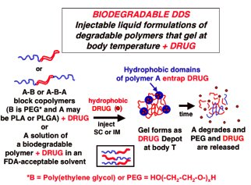
b) In closed-loop systems, or self-regulated systems, the release is in direct response to the conditions detected, be it temperature, type of solvent, pH, or concentration, to name a few. Poly(ethylene glycol) and poly(propylene glycol) copolymers and poly(lactic acid) and poly(glycolic acid) copolymers exhibit thermo-responsiveness.
Poly(N-isopropylacrylamide) is a well-known example of a thermo-responsive polymer. At its transition of 32ºC, the polymer is soluble in water; but, as temperature is increased, the polymer precipitates and phase separates. The drug is dissolved in the liquid form of the polymer at room temperature as shown in the Figure. When this mixture is injected in the body, the polymer turns into a gel, which eventually degrades and releases the drug molecules.
A schematic of a temperature-responsive biodegradable device.

Slide 44
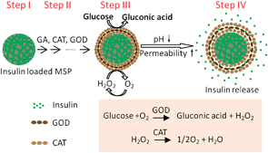
Self-regulating insulin-delivery devices depend on the concentration of glucose in the blood to control the release of insulin. One system proposed immobilizing glucose oxidase (an enzyme) to a pH-responsive polymeric hydrogel, which encloses a saturated insulin solution. At high glucose levels, glucose is catalyzed by glucose oxidase (GOD) and converts it to gluconic acid, thus lowering the pH. This decrease in pH causes the membrane to swell, forcing the insulin out of the device
*glucose-sensitive enzyme multilayer microcapsules have been fabricated by a layer-by-layer technique via cross-linking GOD with glutaraldehyde (GA).

Slide 45
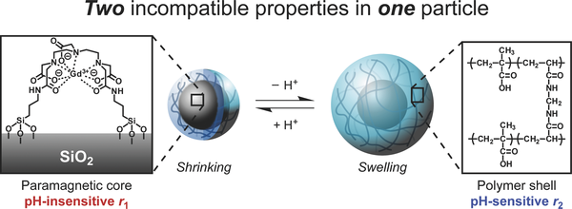
Encapsulation of paramagnetic gadolinium into polymeric microspheres enables detection of microspheres at magnetic resonance imaging (MRI). Compared with biopsy or surgery , MRI enables early detection and treatment of diseases and it is a noninvasive technique.
* cancer cells only thrive(gelişmek, büyümek) in an acidic environment.

