Slide 1
The Nobel Prize in Chemistry, 2000:
Conductive polymers
Professor Alan J. Heeger at the University of California at Santa Barbara, USA
Professor Alan G. MacDiarmid at the University of Pennsylvania, USA and
Professor Hideki Shirakawa at the University of Tsukuba, Japan
rewarded the Nobel Prize in Chemistry for 2000 “for the discovery and development of electrically conductive polymers”.

Slide 2
What is electrical conductivity?
Conductivity is defined by Ohm’s law:
U = R I
where I is the current (in Amperes) through a resistor and U is the drop in potential (in Volts) across it. R is called the “resistance”, measured in Ohms (Ω). R is measured by applying a known voltage across the resistor and measuring the current through it.
The reciprocal of resistance (R^{–1}) is called conductance.

Slide 3
In Ohmic material, the resistance is proportional to the length l of the sample and inversely proportional to the sample cross-section A:
R = ρ l / A
where ρ is the resistivity measured in Ω cm (in SI units Ω m).
Its inverse σ = ρ^{–1} is the conductivity.
The unit of conductance is the Siemens (S = Ω ^{–1}).
The unit of conductivity is S m^{–1}.
* Not all materials obey Ohm’s law. Semiconductors and what are termed “one dimensional conductors” (e.g.a linear polyene chain) generally all deviate from Ohm’s law.

Slide 4
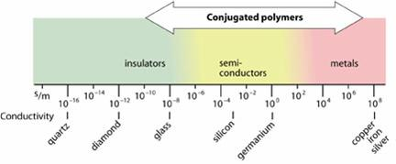
Polymers may also have conductivities corresponding to those of semiconductors.
FIGURE 1. Conductivity of conductive polymers compared to those of other materials, from quartz (insulator) to copper (conductor).

Slide 5
*Conductivity depends on: the number density of charge carriers (number of electrons, n) and how fast they can move in the material (mobility, μ)
σ = n μ e
where “e” is the electron charge.
*In semiconductors and electrolyte solutions, one must also add in the above equation an extra term due to positive charge carriers (holes or cations).
*Conductivity depends on temperature: it generally increases with decreasing temperature for “metallic” materials (some of which become superconductive below a certain critical temperature Tc), while it generally decreases with lowered temperature for semiconductors and insulators.

Slide 6
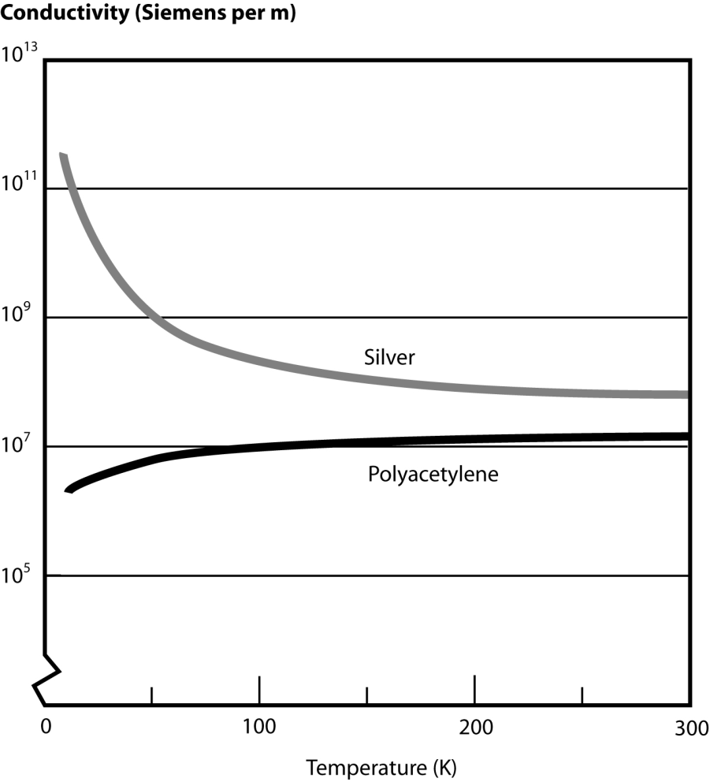
FIGURE 2. The conductivity of conductive polymers decreases with falling temperature in contrast to the conductivities of typical metals, e.g. silver, which increase with falling temperature.

Slide 7
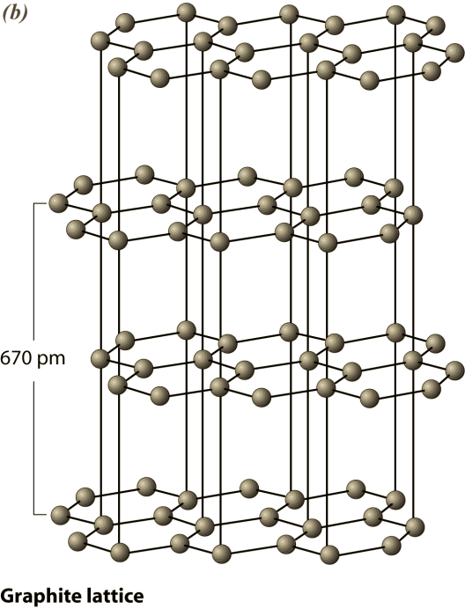
What makes a material conductive?
Three simple carbon compounds are diamond, graphite and polyacetylene. They may be regarded, respectively, as three- , two- and one-dimensional forms of carbon materials. Diamond and graphite are modifications of pure carbon, while in polyacetylene one hydrogen atom is bound to each carbon atom.

Slide 8
In many materials, macroscopic properties such as strength and optical and electrical properties generally depend on direction. They are said to be anisotropic.
Diamond, which contains only σ bonds, is an insulator and its high symmetry gives it isotropic properties.
Graphite and acetylene both have mobile π electrons and are, when doped, highly anisotropic conductors. The conductivity is about one million times greater in the plane of the graphite rings than at right angles to this plane:
σ (parallel)/ σ(perpendicular) = 10⁶ .
Correspondingly, the conductivity of stretch oriented polyacetylene is some 100 times higher in the stretch direction than perpendicular to it.

Slide 9
Conductive polymers – the story
In the early 1970s Shirakawa and co-workers make well-defined films of polyacetylene. They produced a copper-coloured film of all-cis-polyacetylene and also silvery all-trans-polyacetylene. Their conductivities were:
cis-polyacetylene 10^{–8}-10^{–7} S.m^{–1}
trans-polyacetylene 10^{–3}-10^{–2} S.m^{–1}

Slide 10
Conductive polymers – the story
In 1975 Professors Alan Heeger and Alan MacDiarmid collaborated to study the metallic properties of a covalent inorganic polymer. They shifted their attention to polyacetylene after MacDiarmid had met Shirakawa in Tokyo.
MacDiarmid wanted to modify the polyacetylene by iodine treatment. Conductivity of 3000 S.m^{–1} was measured for iodine-modified trans-polyacetylene, an increase of seven orders of magnitude over the undoped material.
The seminal paper received for publication in 1977, had the title: Synthesis of electrically conducting organic polymers: Halogen derivatives of polyacetylene (CH)x.
Doping cis-polyacetylene with AsF₅ resulted in an increase of conductivity by a factor of 10¹¹. The high conductivity found by Heeger, MacDiarmid and Shirakawa clearly opened up the field of “plastic electronics”.

Slide 11
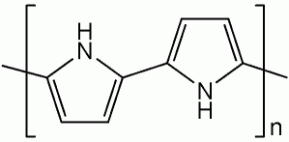
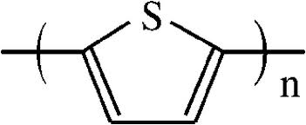
*Polyacetylene remains the most crystalline conductive polymer but is not the first conductive polymer to be commercialized. This is because it is easily oxidised by the oxygen in air and is also sensitive to humidity.
*Polypyrrole and polythiophene differ from polyacetylene most notably in that they may be synthesized directly in the doped form and are very stable in air. Their conductivities are low, however: only around 10⁴ S.m^{–1}, but this is enough for many practical purposes.
Polypyrrole
Polythiophene

Slide 12
The energy spacing between the highest occupied and the lowest unoccupied bands is called the band gap. The lowest unoccupied band is called the conduction band and the highest occupied one the valence band.
The conductivity of the metal is due either to only-partly-filled valence or conduction bands, or to the band gap being near zero, so that with even a weak electric field the electrons easily redistribute: electrons at higher energy and holes at lower energy.

Slide 13
Assume a row of N atoms separated by a distance d, so the total length of the chain is (N–1)d or, for large N, approximately Nd.
The energy required to excite an electron from HOMO to LUMO is:
*Obviously the band gap is predicted to decrease as 1/N with increasing polymer length, and will thus practically vanish for macroscopic dimensions.

Slide 14
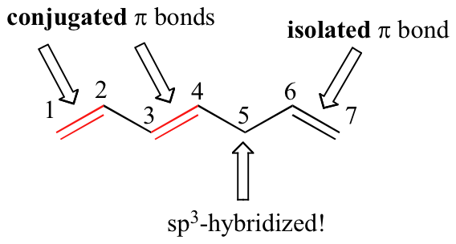
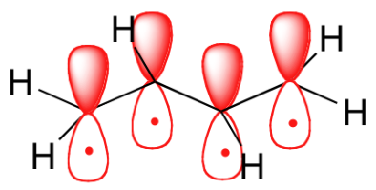
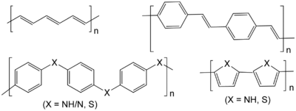
A key property of a conductive polymer is the presence of conjugated double bonds along the backbone of the polymer. In conjugation, the bonds between the carbon atoms are alternately single and double.
The presence of C₅ makes it impossible for the π electrons of the C₆-C₇ pi bond to join the conjugated system on the first four carbons.
Chemical structures of some conductive polymers. From top left clockwise: polyacetylene; polyphenylene vinylene; polypyrrole (X = NH) and polythiophene (X = S); and polyaniline (X = NH/N) and polyphenylene sulfide (X = S).

Slide 15
Conjugation is not enough to make the polymer material conductive. In addition – and this is what the dopant does – charge carriers in the form of extra electrons or ”holes” have to be injected into the material.
A hole is a position where an electron is missing. When such a hole is filled by an electron jumping in from a neighbouring position, a new hole is created and so on, allowing charge to migrate a long distance.
The “doped” form of polyacetylene had a conductivity of 10⁵ Siemens per meter, which was higher than that of any previously known polymer. As a comparison, teflon has a conductivity of 10^{–16} S.m^{–1}and silver and copper 10⁸ S.m^{–1}.

Slide 16

Mechanism of polymer conductivity – role of doping
The halogen doping that transforms polyacetylene to a good conductor of electricity is oxidation (or p-doping).
Reductive doping (called n-doping) is also possible using, e.g., an alkali metal.
The doped polymer is thus a salt. However, it is not the counter ions, I₃– or Na⁺, but the charges on the polymer that are the mobile charge carriers.

