Slide 1
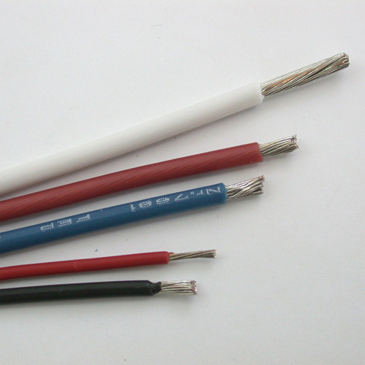
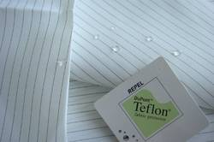
Polymer Coatings
A coating is a covering that is applied to the surface of an object, usually referred to as the substrate. The purpose of applying the coating may be decorative, functional, or both.
Functional coatings may be applied to change the surface properties of the substrate, such as adhesion, wetability, corrosion resistance, or wear resistance.
Non-stick PTFE coated- cooking pans: Changing adhesion properties.
Insulating coatings: Insulating material is used as a protective coating on electrical wire and cables. Material like PVC, Teflon and rubber are very good electrical insulators.
Teflon coated fabric

Slide 2
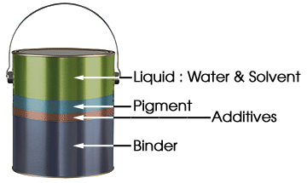
Basic Composition of Paint
Paints and lacquers: Coatings have dual uses of protecting the substrate and being decorative. (The paint on large industrial pipes is presumably only for the function of preventing corrosion).
Solvents (Liquids)
Pigments
Additives
Resins (Binder)
REF: Comex group ppt: PAINT BASICS AND CORROSION IN METAL AIA103
2

Slide 3
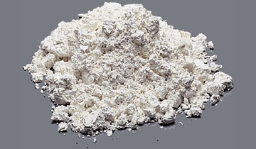
Prime Pigments
Titanium Dioxide (TiO₂)
    most widely used white pigment because of its brightness and very high refractive index
    Zinc Oxide
    controls mildew (küf)
    resists ultra-violet light
    resists yellowing
Titanium dioxide is the world's primary pigment for providing whiteness, brightness and opacity.
3

Slide 4
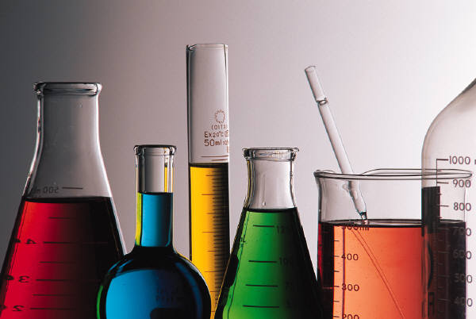
Resins
Types: Latex, Alkyd, Epoxy, Polyurethane
Binds or glues ingredients (pigments and additives) of paint together
Resin provides adhesion to the substrate
Resin provides durability & resistance properties:
    UV-resistance
    Moisture resistance
    Chemical resistance
    Stain resistance
    Fade resistance
REF: Comex group ppt: PAINT BASICS AND CORROSION IN METAL AIA103
4

Slide 5

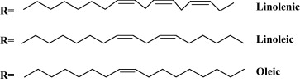
Alkyd Resin Technology
ALKYD (Oil-Based)
  A synthetic resin made by reacting alcohols and fatty acids
  Benefits of alkyds:
    Abrasion resistance
    Good adhesion
    Used in rust preventative paint
Alkyd resin
REF: Comex group ppt: PAINT BASICS AND CORROSION IN METAL AIA103
5

Slide 6

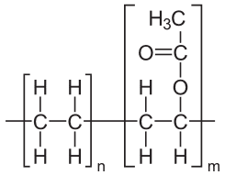
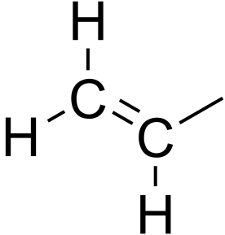
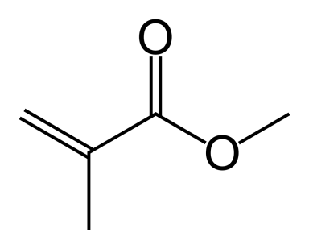
Latex Resin Technology
LATEX (water-based)
    Synthetic polymers
    Main resins:
      100% Acrylic
      Styrene Acrylic
      Vinyl-Acrylic
      Acrylic Copolymer
      Ethylene Vinyl Acetate
QUALITY Latex paint benefits include:
Color retention
Excellent adhesion
Scrub resistance
Low odor
Acrylic acid
Chemical structure of the vinyl functional group
Ethylene-vinyl acetate
REF: Comex group ppt: PAINT BASICS AND CORROSION IN METAL AIA103
MMA
6

Slide 7
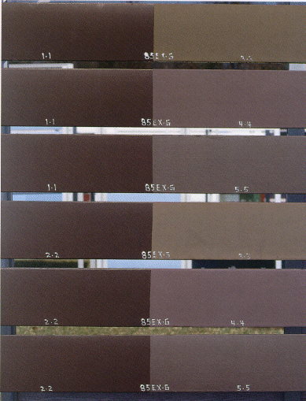
Acrylic vs. Alkyd Paints
The paint on the left half of each board is acrylic, the paint on the right half, an alkyd.
The colors of the paints were identical when applied. After 15 years of weathering, the appearance of the alkyds has changed dramatically.
All have lost gloss, faded, and chalked. The acrylic paints, in contrast, have proven remarkably durable with good color retention.
REF: Comex group ppt: PAINT BASICS AND CORROSION IN METAL AIA103
7

Slide 8
Coating Methods
Pieces Coating Methods
Painting
Spraying
Dipping
Film or sheet Coating Methods
Rolling
Calendering
Transfer Coating
Extrusion

Slide 9


Painting
Painting is the practice of applying paint to a surface. The medium is commonly applied to the base with a brush. This is the simlest coating technique.
Spraying
This process occurs when paint is applied to an object through the use of an air-pressurized (compressed gas)spray gun. The air gun has a nozzle, paint basin, and air compressor. When the trigger is pressed the paint mixes with the compressed air stream and is released in a fine spray.
Air gun spraying uses equipment that is generally larger and used for covering large surfaces with an even coating of liquid.

Slide 10
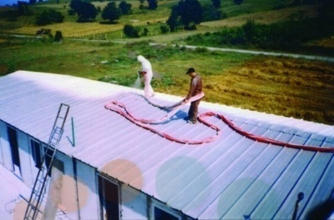
Ürün : Püskürtme Poliüretan
(Poliüretan Sert Köpük)
Marka : İzoroof
Kısa Tanım : Yerinde özel makineler ile püskürtülerek uygulanan sistemlerdir. Ek yeri olmayan tek parça bir izolasyon elde edilir. Isı ve ses izolasyonu amacı ile uygulanmaktadır.
Uygulama Alanları : Fabrika çatıları (eski-yıpranmış), inşaatlar, konutlar, tavuk çiftlikleri, mantar çiftlikleri, balıkçı tekneleri, soğuk hava depoları, her türlü çatı ve zemin yalıtım, perde beton yalıtımı.
Teknik Özellikler : Isı geçirgenlik direnci: 24,6 mW/mK (SI unit=watt/meter.Kelvin)
Basma direnci: 175 kPa
Kapalı hücre miktarı: %15
Alev Dayanımı: B2 (normal alev alır)-B3 (kolay alev alır)
Bükülme Direnci: 0,35 N/mm²

Slide 11
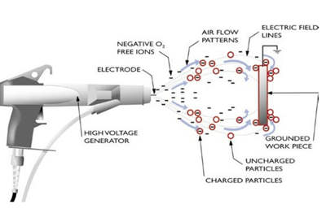
Electrostatic Spraying
The most common method used in powder coating:
High voltage (40-100 kV) concentrated at the nozzle of the spray gun causes ionizing of the air passing through the spray gun.
Passage of the powder through this ionized air allows free ions to adhere some of the powder particles while applying a negative charge to them.
These particles have a strong attraction to the grounded part and deposit there.
This process can apply coatings between 20µm-245µm in thickness. Non-charged powder particles do not adhere to the object and will be recycled. Virtually all resins with the exception of nylon can be applied easily with this process.
http://www.chinapowdercoating.com/conventional-electrostatic-charging

Slide 12
Electrostatic Painting, Powder Deposition: In these deposition processes, a powder (or sometimes a liquid) is atomized and given an electric charge. The charged particles of powder drift toward a conductive workpiece (the item that is being powder painted), usually with additional airflow assist from a fan or pump. The powder is electrostatically attracted to the workpiece and sticks to it. Then the workpiece is heated, which melts the powder so that it forms a smooth, solid coat. Heat (or UV for a low-temperature piece) will also polymerize the melted powder if the coating is permanently-hardening (a thermoset). The applied voltage is usually negative, but it is positive for nylon and some other materials, because each material has its own charging preference. An insulator can also be electrostatically sprayed if it is very thin and is backed by a grounded conductor.

Slide 13
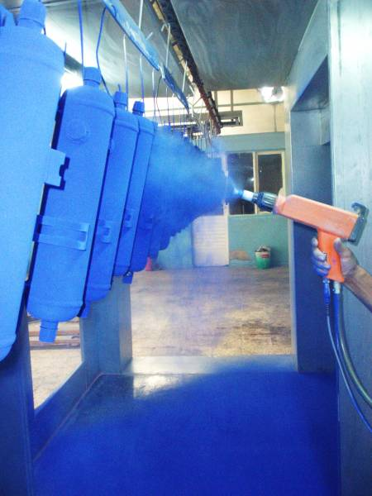
ELEKTROSTATİK TOZ BOYAMA NEDİR ?
Solvent içermeyen bir yüzey kaplama metodudur. Kaplayıcı malzeme, son kat boya tabakasını olusturan çok ince toz boya partikülleridir.
Toz boya, boya kabininde özel boya tabancalari vasıtasıyla atılır. Tabancadan geçerken elektrostatik yüklenen toz boya partikülleri kabin içinde boyanacak malzemeye yapışır ve kaplama işlemi gerçekleşmiş olur. Toz boyanın malzeme yüzeyine tam olarak yapışabilmesi için malzemenin de çok iyi bir şekilde topraklanmasi gerekir. Fazla atilan boya, kabinde bulunan boya geri kazanim sistemi sayesinde toplanır ve tekrar kullanıma sokulur. Boya geri kazanim sistemi elektrostatik toz boyama teknolojisinin en büyük ekonomik avantajlarindan biridir. Malzeme toz boya ile kaplandiktan sonra pisirme fırınına girer. 200ºC olan fırn ısısı toz boyanin erimesini ve malzeme üzerine yapışmasını sağlar. Sonuçta çok dayanıklı, ekonomik, çevre dostu, geniş renk yelpazeli ve parlak bir yüzey kaplamasi elde edilir.
Solvent içermemesi, yüzey kalitesi, dayanıklılığı, boya geri kazanim sistemi, ekonomikligi ve çevre duyarliligi elektrostatik toz boyamayi geleneksel boyama işlemlerine göre daha çekici bir alternatif yapmaktadir.

Slide 14
Toz boya ile boyanacak olan malzemelere uygulanan işlemler;
1) Malzemeler ilk önce yıkama-yağ alma ve durulama-fosfatlama bölümünde işlem görür. Fosfatlama işlemi sayesinde metal yüzey üzerinde koruyucu bir tabaka oluşturulur.Bu sayede metalin hava alması engellenir ve toz boyanın malzemeyi sarması kolaylaşır. Böylece metal üzerinde oluşacak korozyon ve paslanmanın önüne geçilir, malzemenin uzun ömürlü ve dayanıklı olması sağlanır.
2) Daha sonra malzemelerin yüzey temizliği kontrol edilir. Eğer ki malzemelerde çapak varsa temizlenir düzeltme ve zımpara işlemleri yapılır.
3) Malzemeler boyanmak üzere konveyör hattına asılır ve hava tabancaları ile malzemelere hava tutulur. Malzemelerin üzerinde toz ve benzeri kalıntıların kalmadığından emin olunur.
4) Konveyör hattı ilerlemeye başlar ve malzemeler toz boya kabininin içine girer, tabanca sistemleri ile malzemeler toz boya ile boyanırlar.
5) İlerleyen konveyör hattı üzerindeki malzemeler fırından içeriye girmeye başlarlar, malzeme kalınlıklarına göre ve boya kürlenme derecelerine göre fırında özel ısı ve zaman ayarları yapılır.Bu sayade malzemenin kürlenmesi(pişmesi) sağlanır. (Boya kürlenme dereceleri 180-210°C arasındadır)
6) Elektrostatik toz boya ile boyanan malzemeler fırından dışarıya çıkar ve kısa bir süre soğumaya bırakılır.
7) Böylece dayanıklı, sağlam ve estetik açıdan mükemmel bir boya elde edilmiş olur.
Ref: Karyatek Boya

Slide 15
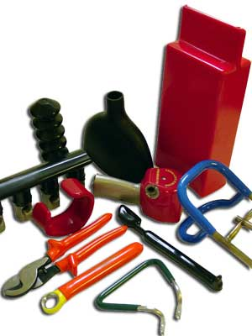
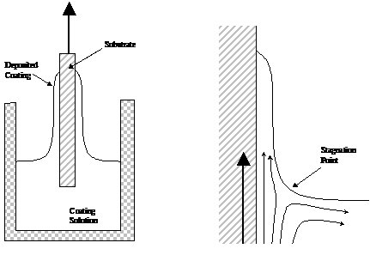
DIP COATING
In a dip-coating process, a substrate is dipped into a liquid coating solution and then is withdrawn from the solution at a controlled speed. Coating thickness generally increases with faster withdrawal speed. The thickness is determined by the balance of forces at the stagnation point on the liquid surface. A faster withdrawal speed pulls more fluid up onto the surface of the substrate before it has time to flow back down into the solution. The thickness is primarily affected by fluid viscosity, fluid density, and surface tension.
Dip-coating, while excellent for producing high-quality, uniform coatings, requires precise control and a clean environment. The applied coating may remain wet for several minutes until the solvent evaporates. This process can be accelerated by heated drying. In addition, the coating may be cured by a variety of means including conventional thermal, UV, or IR techniques depending on the coating solution formulation. Once a layer is cured, another layer may be applied on top of it with another dip-coating / curing process.

Slide 16

Dip Coating
Thickness of layer depends on some parameters like viscosity and solid content of liquid and is formulated:
In which:
h: thickness
ρ: density
g: gravity constant
η: viscosity
γ_{lv}: liquid‐vapor surface tension
v: dtagging speed

Slide 17
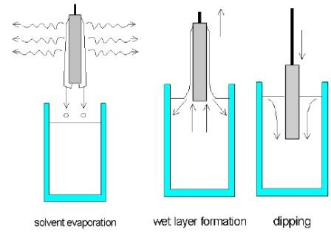
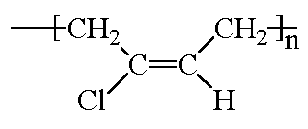
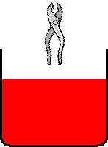
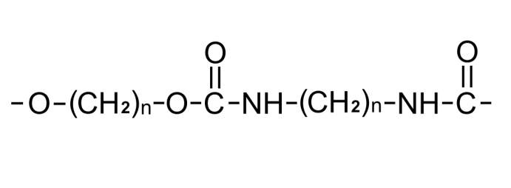

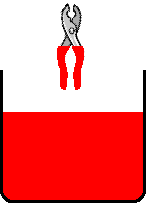
neoprene
polyurethane
Plastisol is the most common dip molding material. It is a mixture of suspended plastic particles (usually PVC) dispersed in a plasticizer. As a liquid, it can be stored at room temperature for years.
Other common candidates for dip molding are latex, neoprene, urethane, epoxy, etc. Recently, polyurethane and silicone are often used to replace latex to avoid allergy related issues.
NOTE: latex is also the name for natural non-vulcanized rubber.

Slide 18
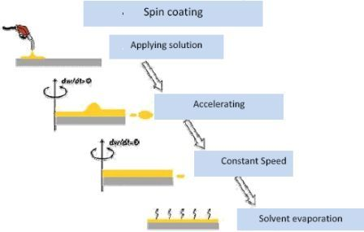
Spin Coating

Slide 19
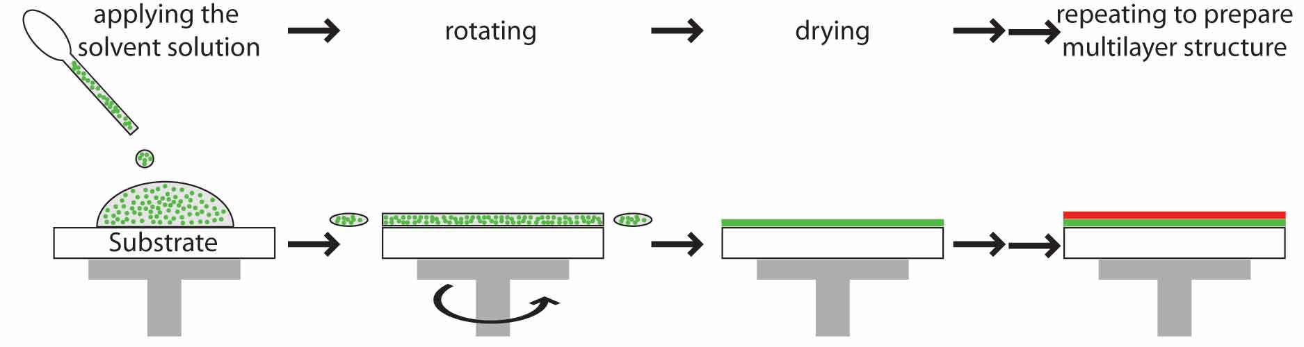
Spin Coating
Spin coating is a cheap and fast method to produce homogeneous layers. An excess amount of the solvent is placed on the substrate, which is then rotated at high speed in order to spread the fluid by centrifugal force. The film thickness can be adjusted by varying the rotation speed, the rotation time, and the concentration of the used solution. The disadvantage of this method is that it is limited by the solvent and that no lateral resolution is possible.
Spin coating is widely used in microfabrication, where it can be used to create thin films with thicknesses below 10 nm. It is used intensively to deposit layers of photoresist (light sensitive materials) about 1 micrometre thick.

Slide 20

Spin Coating
Thickness of the layer depends on many different parameters. Equation 1 shows how these parameters affect thickness:
In which:
h: thickness
ρ_{A}: density of volatile liquid
η: viscosity of solution
m: rate of evaporation
ω:angular speed
Because we have to calculate evaporation rate experimentally, a simpler equation is suggested as below:
A,B are constant parameters that should be calculated experimentally, but in most cases, it has been proved that B is some where between 0.4 and 0.7.

Slide 21
Some technologies that depend heavily on high quality spin coated layers are:
Photoresist* for defining patterns in microcircuit fabrication.
Dielectric/insulating layers for microcircuit fabrication
Magnetic disk coatings
Flat screen display coatings - Antireflection coatings, conductive oxide, etc.
Compact Disks – DVD, CD ROM, etc.
Television tube phosphor and antireflection coatings.
*A photoresist is a light-sensitive material used in several industrial processes, such as photolithography to form a patterned coating on a surface.

Slide 22
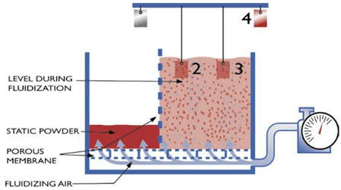
Fluidized Bed Coating
Fluidized bed coating is a commercially important process which was developed for application of plastic coatings on metal substrates. Dry powder coating processes use no solvents and thus provide an environmentally friendly alternative to dipping and spraying. It is possible to build a film thickness of 2500 µm using higher preheat temperatures and multiple dips.
ADVANTAGES
Ability to coat irregular shapes,
Simple and inexpensive equipment requirements,
Process automation,
Smooth and continuous coating applications.
DISADVANTAGES
Pre-heat and post-heat ovens are required
Minimum of 200um to be applied
Complex shapes trap excess powder
The Process Steps :
Sample pre-heated to 200-230C
Initial deposit melts onto part
Film builds from residual heat
Coated part with desired film

Slide 23
Film or Sheet Coating Methods

Slide 24
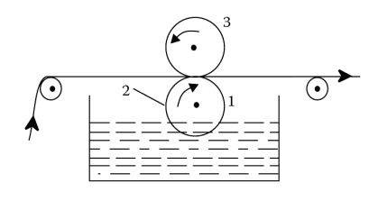
Roll Coating
In this process polymer solution is rolled onto the fabric/film/sheet by a roller suspended in the coating solution, often a blade is positioned close to the roller to ensure not too much coating solution is applied.

Slide 25
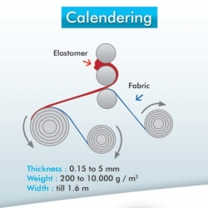
Calendering
Calenders consist of a number of rollers, sometimes five or more in various configurations, which rotate to crush the polymer ‘dough’ and smooth it into films of uniform thickness. The thickness of the film is determined by the gap separation of the rollers. The more rollers, film produced is more accurate. Some of the latter rollers also generates heat, and the polymer fabricated into a continuous sheet can be brought into contact with the fabric to which it adheres.
Application: Textile materials are covered with elastomer on one or both sides.

Slide 26
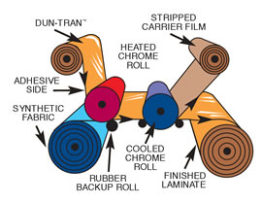
Transfer Coating
The principle of transfer coating is first to spread the polymer on to release paper to form a film and then to laminate this film to the fabric.
The process is divided in few steps like;
● Coat the resin on to the transfer paper
● Coat the adhesive which joins the top layer to the fabric
● Lay the fabric on top of the coating, nip together and crosslink the two layers together
● Peel the coated fabric off the release paper.
Transfer paper
The main uses of this type of coating technique are the transfer coated polyurethane fabrics is in up-market and the waterproof protective clothing.

Slide 27
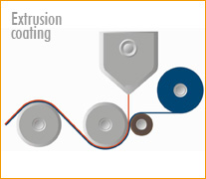
Extrusion coating
In extrusion coating applications, resin is melted and formed into thin hot film, which is coated onto a moving, flat substrate such as paper, paperboard, metal foil or plastic film. The coated substrate then passes between a set of counter rotating rolls that press the coating onto the substrate to ensure complete contact and adhesion.
Coated paperboard used to make cartons for packaging milk, liquid, powdered and solid foods
http://www.lyondellbasell.com/Products/ByCategory/polymers/process/ExtrusionCoating/
http://www.polynov.com/processes/heavyCoating.html

Slide 28
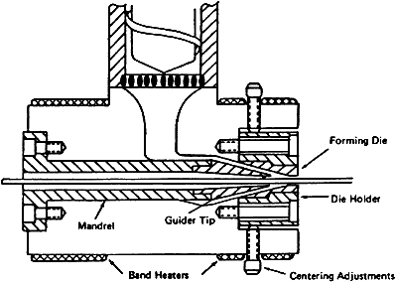
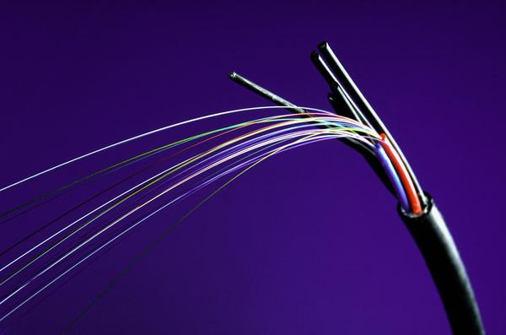
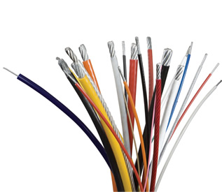
Wire Coating
Steel cable can be jacketed with a number of plastics, and a variety of wall thicknesses. Commonly used plastics include PVC, Nylon, Polypropylene or Polyethylene.
http://www.mindfully.org/Plastic/VCMEmay1973-4.htm

Slide 29
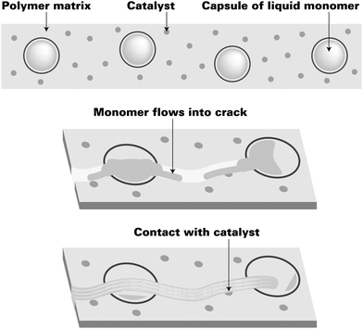
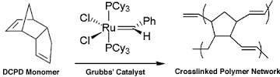
Self-healing of a polymer
One of the self-healing mechanism developed to date incorporates liquid monomer-filled vessels and catalyst particles into a polymer matrix. Upon material fracture, vessels rupture, followed by flow of the liquid monomer into the crack volume. When the monomer contacts the catalyst particles it polymerizes and adheres the crack faces together. The first and most well-studied monomer/catalyst combination used thus far in self-healing systems is dicyclopentadiene (DCPD) and Grubbs' catalyst, the former of which undergoes ring-opening metathesis polymerization (ROMP) in the presence of the latter.

Slide 30
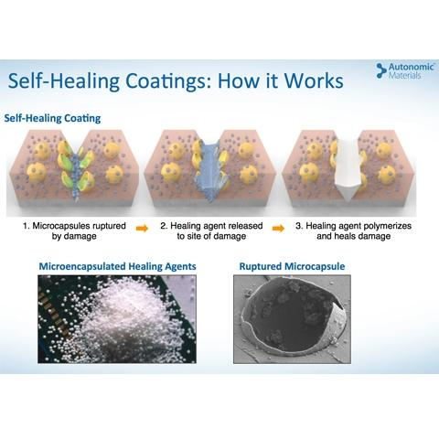

Slide 31
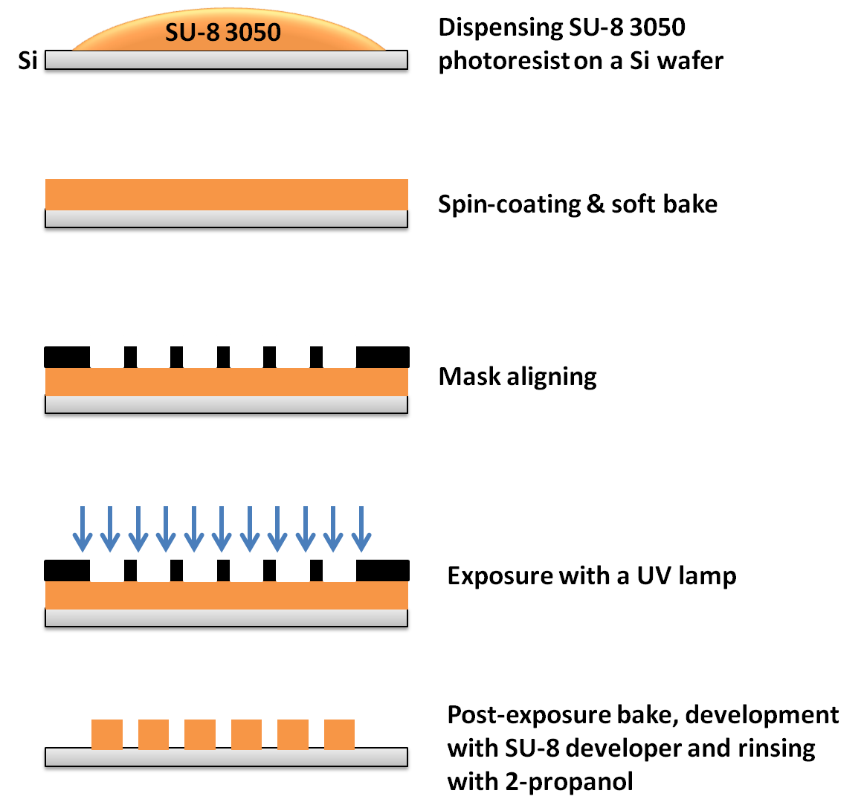
Lithographic patterning using UV light is a very attractive technology due to the relatively low energy consumption, room temperature operation, rapid curing, spatial control and the ability to expose in a single step large surface areas. For these reasons UV lithography is nowadays the most widespread used method for microfabrication.
Schematic illustrations of the steps for the fabrication of the SU-8 micropillars.
Sumio Hosaka, Nanotechnology and Nanomaterials "Updates in Advanced Lithography", ISBN 978-953-51-1175-7, 2013.

Slide 32
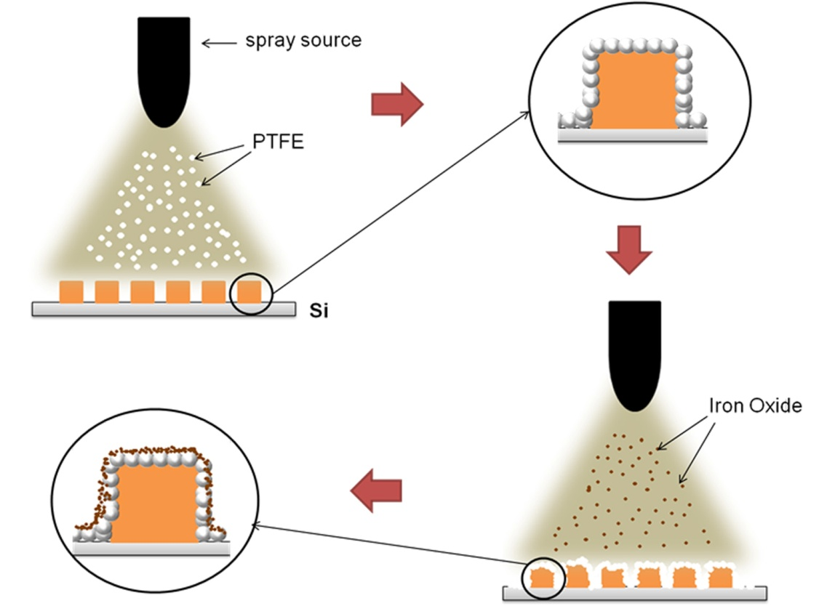
This coating consists of PTFE sub-micrometer particles and iron oxide colloidal NPs and they are applied by spray deposition. Apart from their interesting wetting properties such type of surfaces can be used in various applications such as in biological scaffolds, lab-on-a-chip devices and aerospace vehicles. The substrates, starting from “sticky” hydrophobic (uncoated patterned surfaces), by the application of the proper particles, can be converted to super hydrophobic surfaces with ultrahigh or ultralow water adhesion.
Schematic illustrating the successive coating steps. At first the PTFE solution is sprayed on the substrate. As a second step, the iron oxide NPs are sprayed on top of the Si/PTFE micro/submicron rough pattern, thus inducing a three-scale roughness.
Sumio Hosaka, Nanotechnology and Nanomaterials "Updates in Advanced Lithography", ISBN 978-953-51-1175-7, 2013.

Slide 33
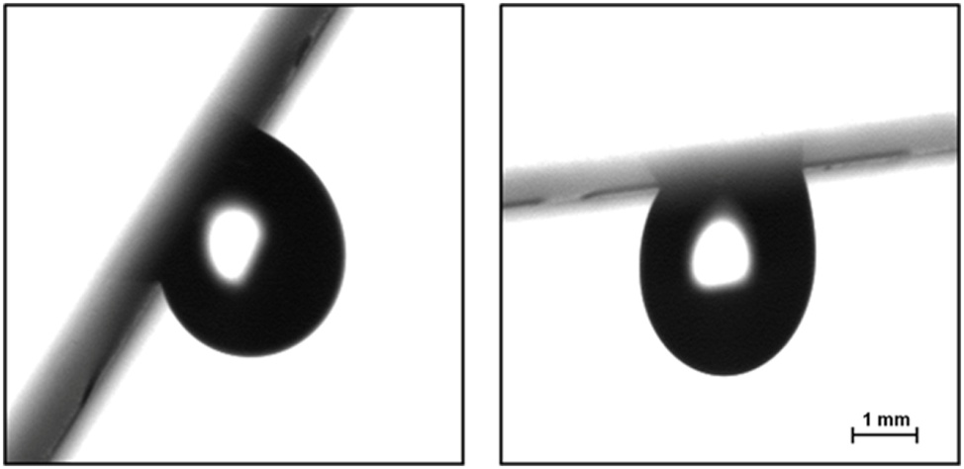
Water drops that remain adhered in an iron oxide/PTFE/SU-8 patterned surface under very high substrate inclinations (tilt angle: 122° on the left image and 173° on the right) Such type of surfacescan be designated as “sticky superhydrophobic” surfaces

Slide 34
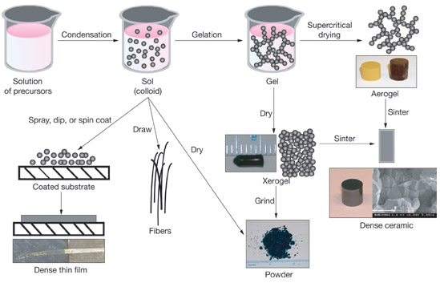
SOL-GEL
In the solgel process, simple molecular precursors are converted into nanometer-sized particles to form a colloidal suspension, or sol. The colloidal nanoparticles are then linked with one another in a 3D, liquid-filled solid network. This transformation to a gel can be initiated in several ways, but the most convenient approach is to change the pH of the reaction solution. Even the method used to remove liquid from a solid will affect the solgel’s properties. For example, to preserve a gel’s original 3D structure and produce low-density aerogels, chemists use a technique called supercritical drying. If, instead, the gel is dried slowly in a fluid-evaporation process, the gel’s structural network collapses, which creates a high-density material known as a xerogel.

Slide 35
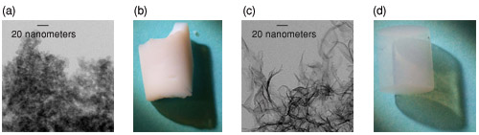
Aerogel properties can be changed by adding different precursor molecules. For example;
(a) an aluminum oxide foam prepared from aluminum nitrate has a cluster morphology that results in (b) an opaque aerogel.
(c) Using aluminum chloride as the precursor produces an aerogel with fibrous morphology, resulting in (d) a stronger foam that is also translucent.

