Slide 1
Electrolytic Etching
It is a simple way to reveal microstructure of metallic alloys
Purpose of etching is to reveale the microstructure of metals and alloys by creating an image contrast.
Electrolytic etching ensues right after an electropolishing operation is completed,
The voltage is dropped to approximately one tenth the potential required for electropolishing
Electrolysis continues for a few more seconds.
Information obtained from as-polished specimens without etching:
Features that exhibit a 10% or greater difference in reflectivity can be viewed without etching.
Some microstructural features with strong colour differences or with large differences in hardness that cause relief formation.
Crack, pores, pits, and nonmetallic inclusions may be observed in the as-polished condition.

Slide 2
To produce an image contrast does not always refer to the selective chemical dissolution of various structural features.
Metallographic contrasting methods include;
electrochemical,
optical, and
physical etching techniques.
Although use of etching is primarily intended for optical examination, polished and etched sections are increasingly examined using the scanning electron microscope with magnifications between those of the optical and transmission electron microscopes.

Slide 3
Methods of Metallographic Etching
Nondestructive techniques, which do not alter the surface of the microsection: It includes
optical etching and
interference layers that are physically deposited on the surfaces of polished specimens.
Destructive methods, which induce surface changes.
1. Nondestructive techniques
Optical etching techniques are;
Dark-field illumination,
Polarized light microscopy,
Phase contrast microscopy, and
Differential interference contrast,
all of which use the Köhler illumination principle known from the most common bright-field illumination mode.

Slide 4
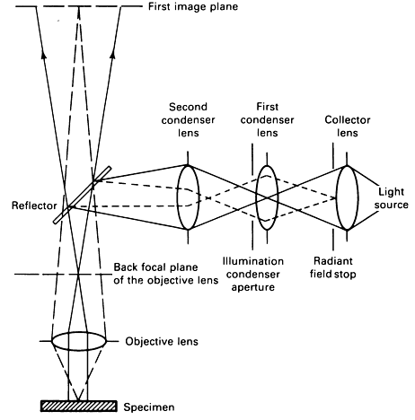
The Köhler principle
Fig. 1 The Köhler illumination principle in incident light microscopy

Slide 5
Some Particulars for Köhler Principle
Provides the uniform illumination of the microsection necessary for obtaining optimum contrast by optical etching.
The collector lens forms an image of the light source at the first condenser lens or at the illumination condenser aperture.
The second condenser lens reproduces the image of the light source in the back focal plane of the objective lens after reflection of the light at the reflector (plane glass, half-silvered mirror, or prism).
Therefore, the surface of the specimen is uniformly illuminated. The condenser lenses and the objective form an image of the radiant field stop in the plane of the specimen surface.

Slide 6
Dark-Field Illumination.
If the difference between the angle of incidence and half the aperture of the cone of light is larger than half the aperture angle of the objective, no regularly reflected light passes through the objective.
This is realized in dark-field illumination (Fig. 2). Only those light rays deflected by diffuse scattering from their original direction toward the optical axis of the microscope are used for image formation.
Therefore, surface regions perpendicular to the optical axis will appear dark, and angled surfaces will appear light.
Dark-field illumination produces contrast completely reversed from that obtained using bright-field illumination.
Optical etching by dark-field illumination is applied to reveal cracks, pores, voids, and inclusions. Nonmetallic inclusions often undergo an intensive brightening by dark-field illumination.
The surface quality of polished microsections can also be controlled using this method, because even very fine scratches and indications of relief formation are revealed.

Slide 7
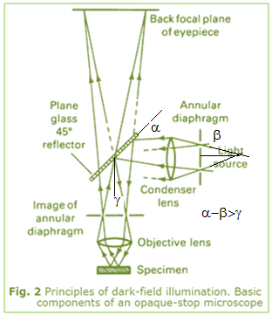

Slide 8
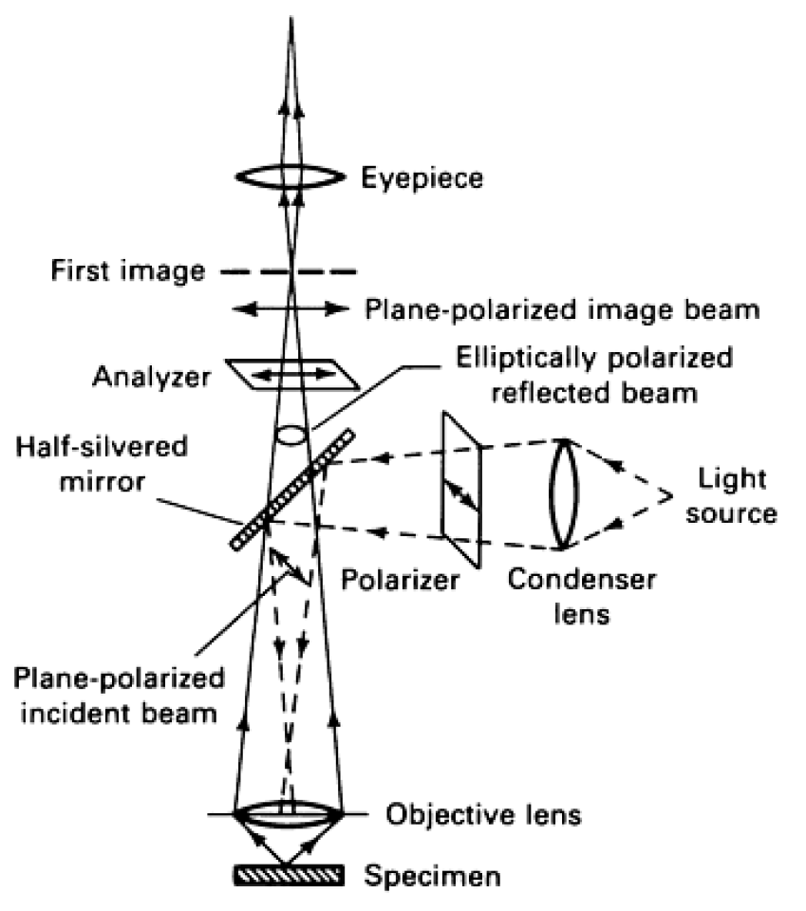
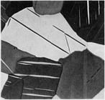
Polarized Light. The basic arrangement for optical etching by polarized light is shown in Fig. 3.
Fig. 4 Grains and deformation twins revealed by polarized light on an as-polished section of cast bismuth. 50×
Fig. 3 Principles of polarized light microscopy

Slide 9
Basic Principles:
The incident light on the specimen is plane polarized by placing a polarizer in front of the condenser lens.
The reflected light is analyzed by a polarizing unit placed behind the eyepiece of the microscope.
This analyzer is normally in a crossed relationship regarding the polarizer, with the plane of polarization of the analyzer perpendicular to that of the polarizer.
Application of this optical etching technique is based on the fact that optically anisotropic metals and phases reflect planepolarized light as elliptically polarized light with a rotation of the plane of polarization.
However, plane-polarized light reflected from the surface of an optically isotropic cubic metal remains unchanged if it strikes at normal incidence.

Slide 10
Under this condition, as-polished cubic metals will appear uniformly dark under crossed polars, because an analyzer in the crossed position will extinguish the unchanged reflected beam.
By contrast, anisotropic metals and phases react to polarized light and exhibit a grain contrast effect under crossed polars as a variation in brightness and color.
Requirements for good results:
well-polished microsection, because surface irregularities, smudges, and surface layers influence the state of polarization and may suppress anisotropic effects.
Chemical and electrolytic polishing, because they avoid plastic deformation of the surface regions, are more successful than mechanical polishing.
Where used ?
Optical etching by polarized light is applied to anisotropic metals and to metal alloys containing anisotropic phases.
for revealing grain structure (Fig. 4) and for distinguishing and identifying phases in multiphase alloys.

Slide 11
Detecting preferred orientation in polycrystalline materials and
Identifying nonmetallic anisotropic inclusions in optically isotropic metal-matrix materials.
Anisotropic surface layers produced by chemical etching or by anodic oxidation of isotropic metals and metal alloys provide a stronger grain contrast when polarized light is used.
For anisotropic material, an increase in grain contrast is observed when the surface of the polished microsection is coated with interference layers before examination under polarized light.
A special application is the examination of polished cross sections of transparent resin, glass, or ceramic layers. Under polarized light, the distinctive colors of these layers can be determined, and cracks or other flaws are revealed.

Slide 12
Phase Contrast Microscopy.
Slight differences in height on polished microsections are invisible in bright-field illumination, because they produce only phase differences between the reflected light waves.
Optical etching using the phase-contrast technique transforms these phase differences into detectable variations in brightness.
To achieve phase contrast, an angular disk is inserted at the front focal plane of the condenser lens, and a transparent phase plate of suitable size is placed in the back focal plane of the objective, as shown in Fig. 5.
Depending on the type of transparent phase plate used, positive or negative phase contrast results. In positive phase contrast, higher areas of the specimen appear bright, and depressions dark. In negative phase contrast, lower areas on the specimen are brighter, and higher areas are darker than the background.
Minimal differences in height of 1-5 nm (10-50 Aº ) are disclosed using this method. The optimum range of differences in surface level is approximately 20-50 nm 200-500 Aº ).

Slide 13
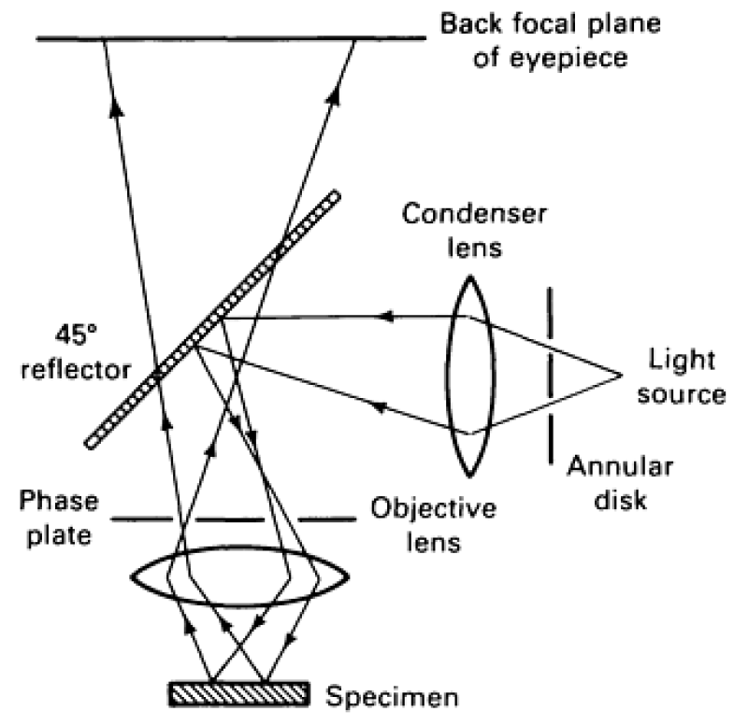
Fig. 5 Principles of phase contrast microscopy

Slide 14
Where Used
The phase-contrast technique can be applied to reveal the microstructure of metals and alloys after polishing or light etching of the microsections.
Examples include (1) the identification of carbide and σ phase in ferritic chromium steel and (2) the identification of σ phase in austenite.
Other applications of phase-contrast microscopy include the study of cleavage surfaces and the observation of twins and slip lines.
It is also useful as an optical etching method in high temperature
(hot-stage) microscopy.

Slide 15
Differential Interference Contrast.
How it works?
Differential interference contrast after Nomarski has found broad application in metallography. The basic arrangement for this optical etching method is shown in Fig. 6.
A ray of light emitted from the light source is linearly polarized after it passes through the polarizer.
The polirized light then enters the Nomarski biprism (Wollaston prism), which consists of two optically uniaxially doubly refracting crystals and is divided into two rays of linearly polarized light.
The planes of vibration of these rays are perpendicular to each other.
Upon passing through the objective, the rays become parallel and impinge on the specimen. After reflection from the specimen surface, they are recombined by the biprism.
Interference is produced when these recombined rays pass through the analyzer.

Slide 16
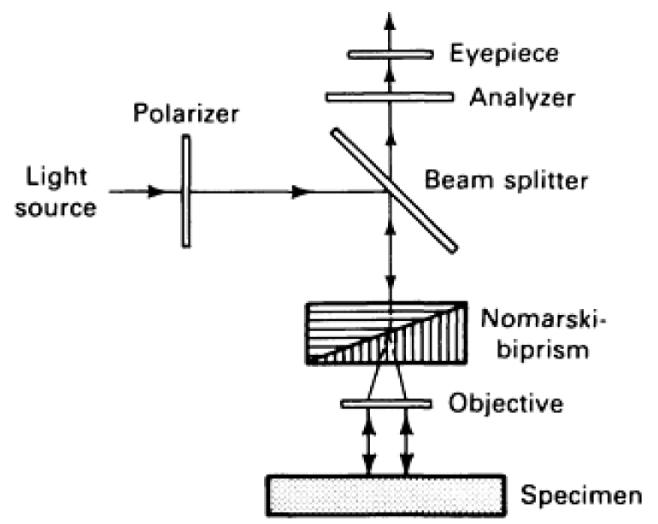
Fig. 6 Principles of differential interference contrast after Nomarski

Slide 17
How it function?
Like normal polarized light microscopy, the analyzer is in a crossed relationship with respect to the polarizer.
Phase differences resulting from the two spatially separated beams reflecting from the specimen are due to differences in height of the surface relief, which are modified by the optical properties of the specimen.
These phase differences cause the light-dark or color interference contrast. Lateral displacement of the biprism allows an additional phase difference to be superimposed that varies color contrast.
The achievable contrast depends on the local gradient of the phase difference. Therefore, this type of contrast is termed differential interference contrast.

Slide 18
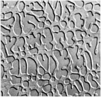
Where used?
To reveal phases of different hardness in polished microsections of metal alloys, layered materials, and materials joints.
To visualize carbide particles in roller bearing and high speed steels.
To study the coherent phase transformations, which produce surface reliefs.
To detect surface and subsurface defects of thin films evaporated or sputtered on metallic or nonmetallic substrates
Fig. 7 Differential interference contrast after Nomarski showing the two-phase structure of a U-33Al-25Co (at.%) alloy. Electrolytically etched. 250×

Slide 19
Contrasting by Interference Layers (Principles).
The method of revealing the microstructure with the aid of physically deposited interference layers (films) is based on an optical-contrast mechanism without chemical or morphological alteration of the specimen surface.
The specimen is coated with a transparent layer whose thickness is small compared to the resolving power of the optical microscope.
In interference layer microscopy, light that is incident on the deposited film is reflected at the air/layer and layer/specimen interfaces (Fig. 8).
Phases with different optical constants appear in various degrees of brightness and colors.
The color of a phase is determined by its optical constants and by the thickness and optical constants of the interference layer.
How layers are deposited? Reactively sputtered and vapor-deposited films are used as an interference layers.

Slide 20
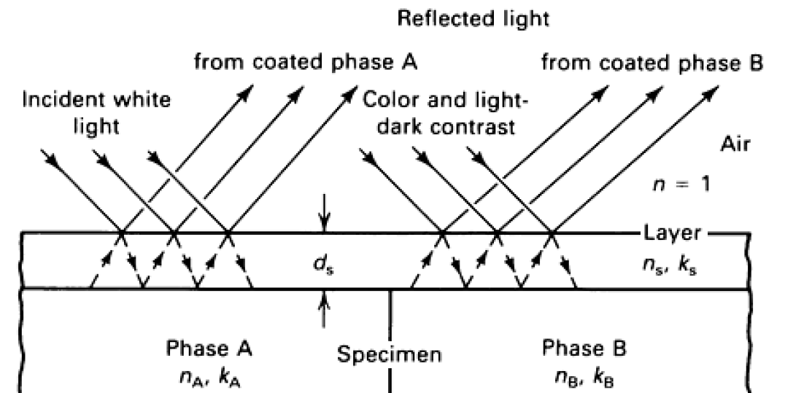
Fig. 8 The function of a physically deposited interference layer. Contrast between phase A and B is achieved by optimizing the optical constants (n_{s}: refractive indices, k_{s}: absorption coefficients) of the layer with respect to the optical constants of the phases (n_{A}, k_{A}, n_{B}, k_{B}) and adjusting the layer thickness d_{s}.

Slide 21
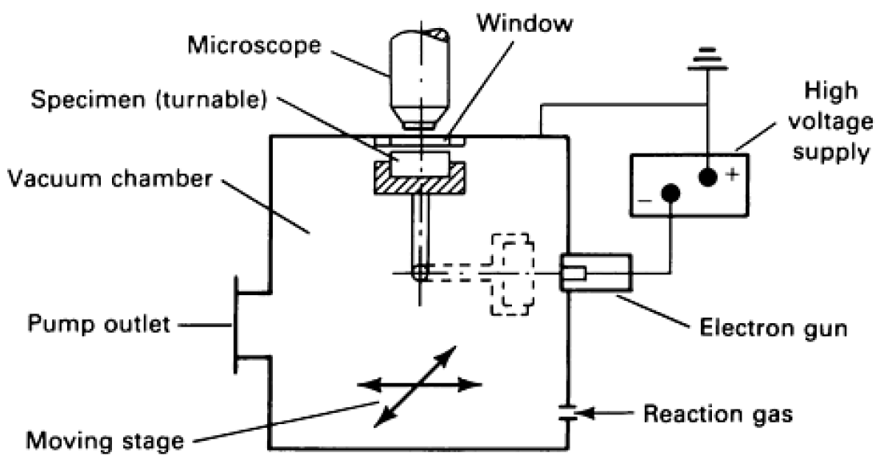
The optimum contrasting conditions is achieved simply by a commercially available contrasting chamber where the results of reactive sputtering can be directly observed by placing the coated specimen under a microscope without removing the specimen from the chamber (see Fig. 9).
The chamber consists of an atomizer with interchangeable cathodes, a high-voltage supply, and an electron gun to ionize the reactive gas (oxygen).
Fig. 9 Gas contrasting chamber used for reactive sputtering and optical examination of interference layers on polished specimens. The results of the reactive sputtering process can be monitored through the viewing window.

Slide 22
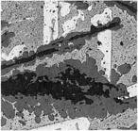
Reproducible results can be maintained when the polished microsection is carefully prepared.
This technique is applied to various metal alloys, composite materials, coatings, and joined materials. For example, good contrast is obtained for aluminium alloys, high-temperature nickel and cobalt alloys, cemented carbides, plasma-sprayed layers, brazed joints, and sintered metals.
Typical results of contrasting by interference layers are illustrated in Fig. 10; four phases can be differentiated on the polished microsection of a cast tin-silver-copper alloy coated with a platinum oxide layer.
Fig. 10 Interference-layer micrograph of a cast Sn-18Ag-15Cu alloy. Polished specimen coated with a platinum oxide layer by reactive sputtering. Structure consists of Ag3Sn (white), Sn (light gray), Cu6Sn5 (medium gray), and Cu3Sn (dark gray). 300×

Slide 23
Destructive Etching (Classification)
The types of destructive etching: (a) electrochemical and (b) physical etching.
The classical electrochemical etching procedures, including conventional etching, are utilized more frequently than physical etching methods which are used primarily when other techniques fail.
Electrochemical (Chemical) Etching.
Main principles:
During the etching (a) cathodic and (b) anodic reactions take place.
All metals contacting the etching solutions tend to become ionized by releasing electrons.
The extent of this reaction can be recorded by measuring the electrochemical potential.
This is performed by comparing the potential of metal versus the standard potential of a reference electrode.
The tabulation of various metals results in the electromotive series of elements: Li⁺, Na⁺, K⁺, Ca⁺⁺, Ba⁺⁺, Be⁺⁺, Mg⁺⁺, Al⁺⁺⁺, Mn⁺⁺, Zn⁺⁺, Cr⁺⁺⁺, Cd⁺⁺, Ti⁺, Co⁺⁺, Ni⁺, Pb⁺⁺, Fe⁺⁺⁺, H⁺, Sn⁺⁺⁺⁺, Sb⁺⁺⁺, Bi⁺⁺⁺, As⁺⁺⁺, Cu⁺⁺, Ag⁺, Mg⁺⁺, Au⁺⁺⁺, Pt⁺⁺⁺.

Slide 24
The elements in table are listed in decreasing electroaffinity. Acids attack all elements preceding hydrogen (H₂) as it evolves.
All elements following hydrogen cannot be attacked without the addition of an oxidizing agent.
Microstructural parts of different electrochemical potential are attacked at varying rates, producing differential etching required for microstructural contrast. Electrochemical etching can be considered "forced corrosion."
The difference in potential of the microstructural parts creates formation of mini micro-cells consisting of small, adjoining anodic and cathodic regions.
Types of inhomogeneities causing micro elements:
Differences in phase composition.
Irregularities present in the crystal such as at grain boundaries.

Slide 25
Inhomogeneities due to deformation (deformed zones), which are less resistant to attack than undeformed material
Inhomojenity in the formation of oxidation layers (regions free of oxides are preferentially etched)
Concentration fluctuation in the electrolyte (low concentration is less resistant)
Differences in electrolyte velocity (higher circulation rates reduce resistance to attack)
Differences in the oxygen content of the electrolyte (aerated solutions are more resistant)
Differences in the illumination intensity, which can initiate differences in potential
Because of differences in potential among microstructural features, dissolution of the surface proceeds at various rates, producing contrast.

Slide 26
Precipitation (Deposit) Etching.
Contrast can also originate from layers formed simultaneously with material dissolution.
In precipitation etching, the material is dissolved at the surface; it then reacts with certain components of the etchant to form insoluble compounds.
These compounds precipitate selectively on the surface, causing interference colors or heavy layers of an inherent color. Heat
Tinting.
Oxide films can be formed by heat tinting. The polished specimen is heated in an oxidizing atmosphere.
Coloration of the surface takes place at different rates according to the reaction characteristics of different microstructural elements under the given conditions of atmosphere and temperature. The observed interference colors allow the differentiation of phases and grains.

Slide 27
Chemical etching
The oldest and most commonly applied technique for producing microstructural contrast.
In this technique, the etchant reacts with the specimen without the use of an external current supply.
Etching proceeds by selective dissolution according to the electrochemical characteristics of the microstructural constituents.

Slide 28
Electrolytic (anodic) Etching.
Electrical potential is applied to the specimen using an external circuit.
Figure 11 shows a typical setup consisting of the specimen (anode) and its counterelectrode (cathode) immersed in an electrolyte (etchant).
During electrolytic etching, positive metal ions leave the specimen surface and diffuse into the electrolyte; an equivalent number of electrons remain in the material.
This results in direct etching, shown as segment AB of the current density versus voltage curve in Fig. 12.
Specimen dissolution without formation of a precipitated layer occurs in this instance. However, if the metal ions leaving the material react with nonmetal ions from the electrolyte and form an insoluble compound, precipitated layers will form on the specimen surface whose thicknesses are a function of the composition and orientation of the microstructural features exposed to the solution.

Slide 29
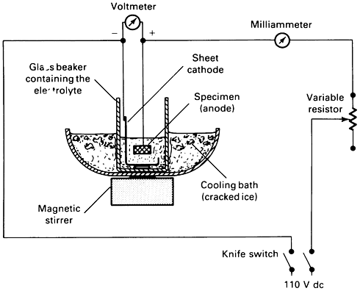
Fig. 11 Basic laboratory setup for electrolytic etching and polishing

Slide 30
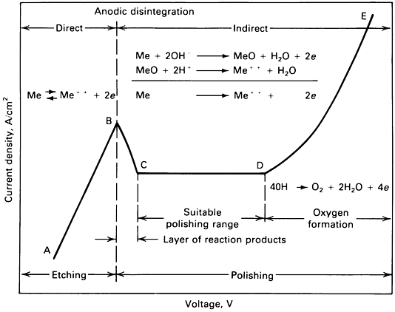
Fig. 12 Idealized current density versus applied voltage for many common electrolytes. Regions for electrolytic etching and polishing are indicated.

Slide 31
Anodizing:
The formation of layers by electrolytic etching that reveal interference colors due to variations in thickness determined by the underlying microstructure.
Zirconium and Hafnium and Their Alloys are good example for anodizing.
Potentiostatic etching:
An advanced form of electrolytic etching that produces the ultimate etching contrast through highly controlled conditions.
The potential of the specimen, which usually changes with variations in electrolytic concentration, is maintained at a fixed level through the use of a potentiostat and suitable reference electrodes.
The principle of this technique is shown in Fig. 13. In some cases, the cell current can be maintained with a coulombmeter to determine the extent of etching (controlled etching).

Slide 32
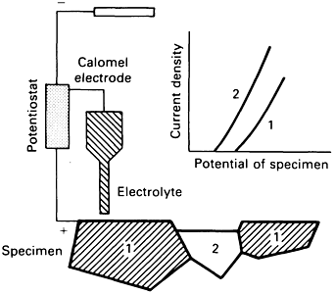
Fig. 13 Principles of electrolytic potentiostatic etching

Slide 33
Physical etching
The surface is free of chemical residues,
offers advantages where electrochemical etching is difficult--for example, when there is an extremely large difference in electrochemical potential between microstructural elements or when chemical etchants cause stains or residues that could produce false microstructures.
(1) Ionic etching and (2) thermal etching are physical etching techniques that alter the morphology of the polished specimen surface.
Some probable applications of these methods are ceramic materials, plated layers, welds joining dissimilar materials, and porous materials.
(1) Ionic etching (or cathodic vacuum etching)
structural contrast is created by selective removal of atoms from the specimen surface by using high energy ions, such as argon, accelerated by voltages of 1 to 10 kV.
Individual atoms are removed at various rates, depending on their atomic number, their bonding state, and the crystal orientation of the individual grains.
Ion beam etching and cathodic sputtering are the ion etching techniques used in metallography and ceramography.

Slide 34
(2) Thermal etching
It is used in high-temperature microscopy and to etch polished surfaces of ceramic materials well below their sintering or hot-pressing temperature.
Thermal etching is also partially based on atoms leaving the material surface as a result of additional energy.
However, the predominant force in thermal etching is the formation of slightly curved equilibrium surfaces having individual grains with minimum surface tension.
Thermal etching of ceramic materials in air, vacuum, or inert gases is often better than conventional chemical etching.
Figure 14 shows as an example the grain structure of a diffusion-welded ceramic joint revealed by thermal etching.

Slide 35
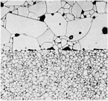
Fig. 14 Polished section of a diffusion-bonded joint between a coarse-grained and a fine-grained alumina ceramic (99.7% Al₂O₃) thermally etched in air at 1400 °C (2550 °F) for 1 h. 500×

