Slide 1
Lens Defects
Many defects result from the laws of reflection and refraction.
The refractive index of a lens varies with the wavelength of light,
the focal length of the lens varies with the refractive index.
As a results focal length will change for different colors of light.
A separate image for each wavelength present is focused at different distances from the lens causing Longitudinal chromatic aberration (Fig. 10).
Moreover, magnification varies with focal length , altering the size of the image resulting in lateral chromatic aberration (Fig. 11).
These aberations must be eliminated for colour photographs. Since achromats have limited corrections for these problems, they must be used with yellow-green light filtering to obtain sharp images.

Slide 2
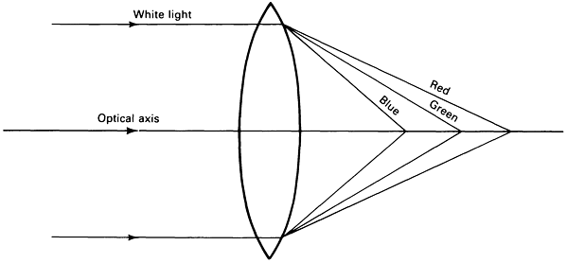
Fig. 10 Longitudinal chromatic aberration in an uncorrected lens. Different wavelengths cause each of the three primary colors to be focused at a different point along the optical axis.

Slide 3
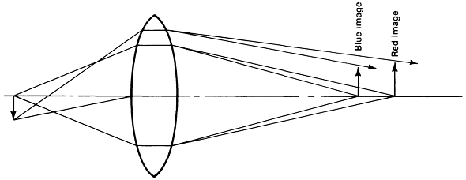
Fig. 11 Lateral chromatic aberration. As focal length is varied, magnification changes, altering image size.

Slide 4
Spherical aberration (Fig. 12)
It occurs due to the refraction differences between the center and the periphery of the lens.
Light from an object on the optical axis is more strongly refracted at the periphery of the lens than at the centre, producing a series of focal positions where point images appear.
This can be minimized by using an aperture that restricts use of the objective to the central portion. Lens design also can correct part of this problem.

Slide 5
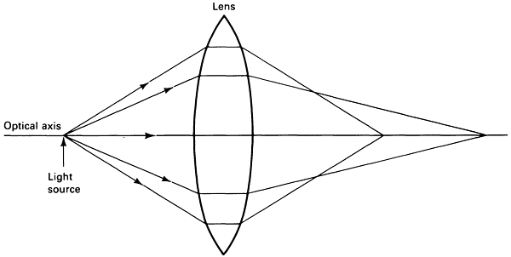
Fig. 12 Spherical aberration. Light rays passing through the outer portion of the lens are more strongly refracted than those passing through the central portion and are focused at a different point along the optical axis. This problem can be minimized by using an aperture to restrict the light path to the central part of the
objective.

Slide 6
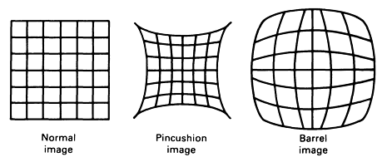
Fig. 13 Image distortions caused by curvature in the image surface of best focus. A compensating eyepiece, with a curvature equal to but opposite of that of the image surface, must be used to produce a normal image.

Slide 7
Resolution
Adequate resolution, or resolving power, and adequate image contrast is required to see microstructural detail.
Acceptability of only one of these is not enough to observe the detail.
Power of resolution is the ability to resolve two points or lines separated by a distance d and is a function of the wavelength, λ, of the incident light and the numerical aperture, NA, of the objective.
where k is 0.5 or 0.61. Figure 14 illustrates this relationship for
k = 0.61 and four light wavelengths.
Equation 2 does not include other factors influencing resolution, such as the degree of correction of the objectives and the visual acuity of the microscopist.
It was based on the work of Abbe under certain conditions such as self-luminous points, perfect black-white contrast, transmitted-light examination, an ideal point-light source, and absence of lens defects (Ref 11).

Slide 8
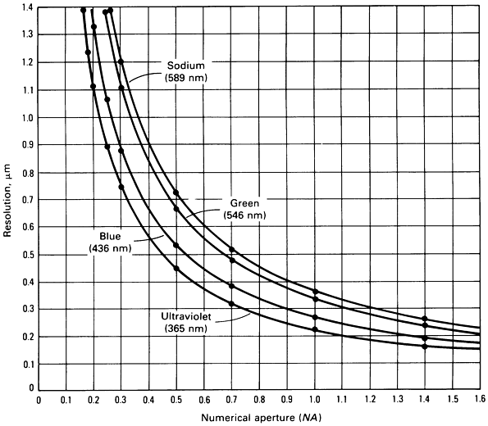
Fig. 14 Relationship between the resolution possible with an incident-light microscope and the numerical aperture of the objective lens used for four wavelengths of light

Slide 9
The limit of resolution for an objective with an NA of 1.4 used with a green light (λ=0,546 μm) is calculated by using Eq 2 and found approximately 0.2 μm.
This means that the two points 0,2 μm apart from each other can be observed by using this objective. But 0,2 μm is beyond the power of resolution of human eyes. Therefore the distance 0,2 μm should be so magnified as to seen by the naked human eye.
The required magnification can be determined by dividing the resolving power of the objective by the resolving power of the human eye, which is difficult to determine under observation conditions.
Abbe used a value of 0.3 mm at a distance of 250 mm--the distance from the eye for optimum vision. For light with a mean wavelength of 0.55 μm, the required magnification is 1100 times the NA of the objective.
This is the origin of the 1000 NA rule for the maximum useful magnification. Any magnification above 1000 NA is termed "empty," or useless.

Slide 10
1000 NA rule can not be strictly followed due to the fact that the reel conditions encountered in metallographic reality is far from what Abbey assumed.
Therefore It has been suggested that the upper limit of useful magnification for the average microscopist is 2200 NA, not 1000 NA (Ref 11).
Depth of Field
Depth of field is the distance along the optical axis over which image details are observed with acceptable clarity.
Those factors influencing resolution also affect depth of field, but in the opposite direction.
Therefore, a compromise must be reached between these two parameters, which becomes more difficult as magnification increases. This is one reason light etching is preferred for high-magnification examination. The depth of field, Tf, can be estimated from:

Slide 11
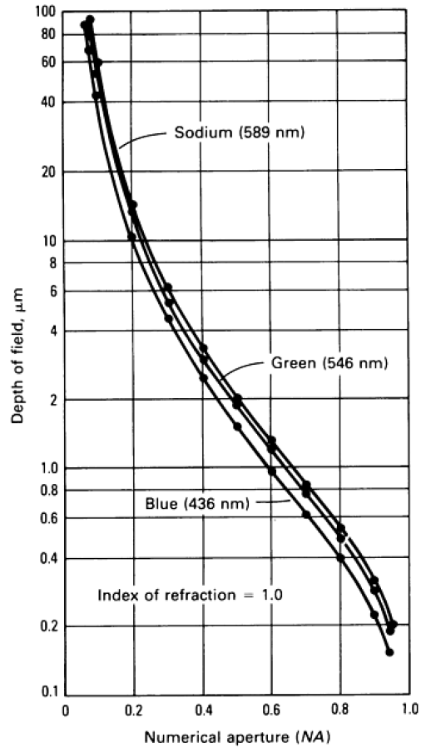
Here λ, n and NA have the usual meaning, being wavelength, refractive indices and numerical aperture respectively.
Fig. 15 Relationship among depth of field of the image produced, numerical aperture of the objective used, and wavelength of light employed

Slide 12
Examination Modes
To achieve the resolution capability of the selected objective, image contrast must be adequate.
Image contrast depends on specimen preparation and optics.
Differences in light reflectivity from the specimen surface produce amplitude features visible to the eye after magnification.
Phase differences created by light reflection must be rendered visible by the use of phase-contrast or interference-contrast attachments to the microscope.

Slide 13
Bright-Field Illumination.
It is the most widely used method of observation, accounts for the vast majority of micrographs taken.
In operation, light passes through the objective and strikes the specimen surface perpendicularly.
Surface features normal to the incident light reflect light back through the objective to the eyepieces, where the surface features appear bright.
Surfaces oblique to the light beam reflect less light to the objective and appear darker, depending on their angle.

Slide 14
Oblique Illumination.
It is possible to de-center the condenser assembly in some microscopes, or the mirror so that the light passing through the objective strikes the specimen surface at a non-perpendicular angle.
Roughness on the specimen surface will cast shadows, producing a three-dimensional appearance.
This allows determination of features that are in relief or are recessed.
However, very little obliqueness can be introduced, because this technique causes lighting to become non-uniform and reduces resolution.

Slide 15
Dark-field illumination,
The light reflected from obliquely oriented features is collected,
The rays reflected from features normal to the incident beam are blocked.
Therefore, the contrast is essentially reversed from that of brightfield illumination; that is, features that are bright in bright-field illumination appear dark, and features normally dark appear bright.
This produces very strong image contrast, with the oblique features appearing luminous. Under such conditions, it is often possible to see features not visible using bright-field illumination.
This method is particularly useful for studying grain structures.
However, the low light intensity makes photomicroscopy more difficult, a problem lessened by the use of automatic exposure-control devices.

Slide 16
Polarized light (Ref 12, 13, 14),
Its use in metallography has generally been limited for some optically anisotropic metals, such as beryllium, a-titanium, zirconium, and uranium,
These metals are difficult to etch but respond well to polarized light when properly polished.
Before development of the electron microprobe analyzer (EMPA) and energydispersive spectroscopy (EDS), polarized light examination was an integral part of the procedure for identifying inclusions.
Since the development of these instruments, polarized light has been used less frequently for this purpose, because identification with the EMPA or EDS techniques is more definitive.
Most metallurgical microscopes now use synthetic Polaroid filters. The "polarizer" is placed in the light path before the objective, and the "analyzer" is placed in the light path after the objective, generally just below the eyepiece.
Figure 26 shows the light path in the incident-light polarizing microscope.

Slide 17
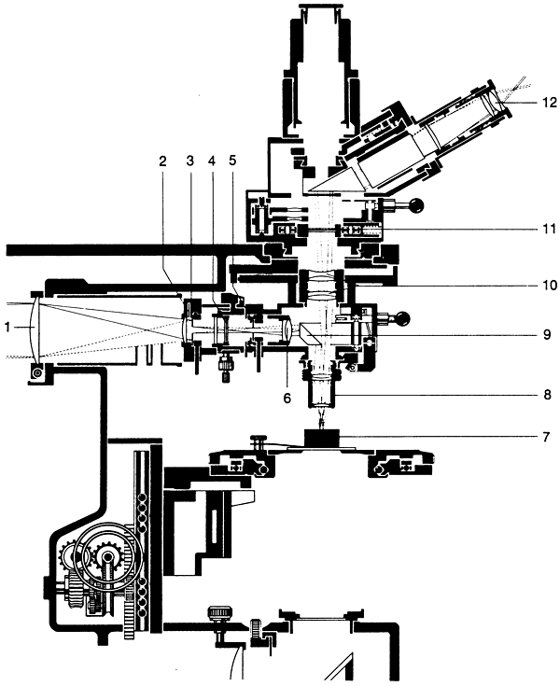
Fig. 26 Light path in an incident-light polarizing microscope. 1, Hinged lens; 2, half stop; 3, aperture diaphragm; 4, filter or prism polarizer; 5, field diaphragm; 6, centrable lens, used to center the field diaphragm; 7, polished section; 8, objective; 9, compensating prism, with switchover against optical-flat reflector; 10, tube lens (intermediate optical system); 11, rotating analyzer; 12, eyepiece with focusing eyelens. (E. Leitz, Inc.)

Slide 18
Light vibrating in all directions at right angles to the direction of propagation passes through a polarizing filter, the vibrations occur in only one plane in the direction of propagation, and the light is termed plane-polarized.
This plane will change as the filter is rotated.
When the analyzer filter is placed in the light path, plane-polarized light will pass through it if the plane of vibration of the light is parallel to the plane of vibration of the analyzer. Otherwise the light will not pass through, and extinction results.
When plane-polarized light is reflected from the surface of an isotropic metal (any metal with a cubic crystallographic structure, such as iron), then passes through the analyzer in the crossed position (plane of vibration perpendicular to that of the plane-polarized light), the image is extinguished, or dark.
However, in practice, because the metallurgical microscope will not produce perfectly plane-polarized light, complete extinction will not occur.
Strain-free objectives, usually achromats, must be used. Fluorite or apochromatic objectives are unsuitable. A strong white-light source is required to produce accurate color effects.

Slide 19
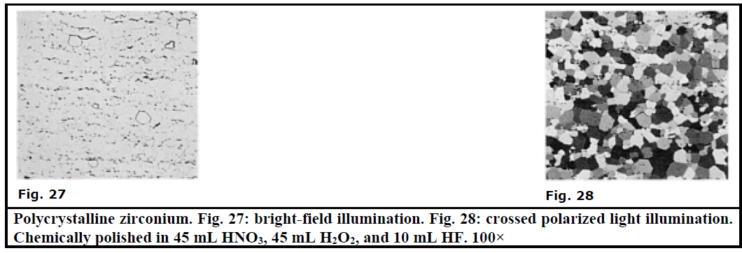
It may be difficult to set the polarizer and analyzer in the crossed position accurately when an anisotropic specimen is in place unless the crossed positions are marked on the polarizer and the analyzer,
it is best to find this position first using an isotropic specimen.
Isotropic metals can also be examined using crossed-polarized light if only the surface can be rendered optically active by etching, staining, or anodizing.

Slide 20
Use of polarized light:
It is good to examine inclusions, anisotropic metals (antimony, beryllium, bismuth, cadmium, cobalt, magnesium, scandium, tellurium, tin, titanium, uranium, zinc, and zirconium, for example), and etched/anodized/tintetched cubic metals,
polarized light is also useful for examination of coated or deformed metals.
Phase identification may also be aided in some cases. The internal structure of graphite nodules in cast iron is vividly revealed using polarized light (Fig. 29, 30, 31).
Martensitic structures are frequently better revealed using polarized light, as shown in Fig. 32 and 33, which illustrate lath martensite in a high-strength iron-base alloy, AF 1410.

Slide 21
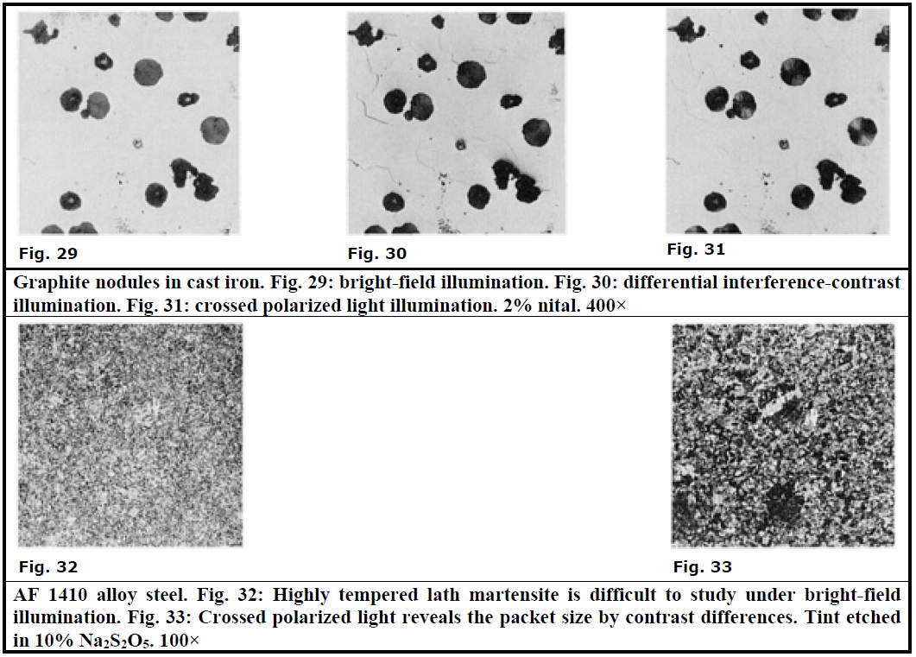

Slide 22
Phase contrast illumination
Application of phase-contrast illumination in metallography has been limited. The technique requires a separate set of objectives and a special vertical illuminator.
It allows examination of subtle phase variations in microstructures with little or no amplitude contrast from differences in the optical path at the surface (reflected light) or from differences in the optical path through the specimen (transmitted light).
Height differences as small as 0.005 μm can be detected.

Slide 23
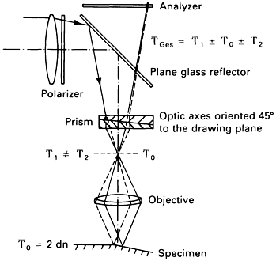
Interference-Contrast Illumination.
Differential interference-contrast (DIC) illumination (Ref 17, 18, 19) produces images with emphasized topographic detail similar to those observed using oblique illumination.
Detail that is invisible or faintly visible using bright-field illumination may be revealed vividly with interference-contrast illumination.

Slide 24
Interference Techniques.
Several interference techniques (Ref 20, 21) are used to measure height differences on specimens.
Interference fringes on a perfectly flat surface appear as straight, parallel lines of equal width and spacing.
Height variations cause these fringes to appear curved or jagged, depending on the unit used.
The interference microscope divides the light from a single point source into two or more waves that are superimposed after traveling different paths.
This produces interference. Two-beam and multiple-beam instruments are the two basic types of interferometers used.
The measurements are based on the wavelength of the light used. Two-beam interferometers can measure height differences as small as λ/20; multiple-beam interferometers, as small as λ/200.

